Slide 1
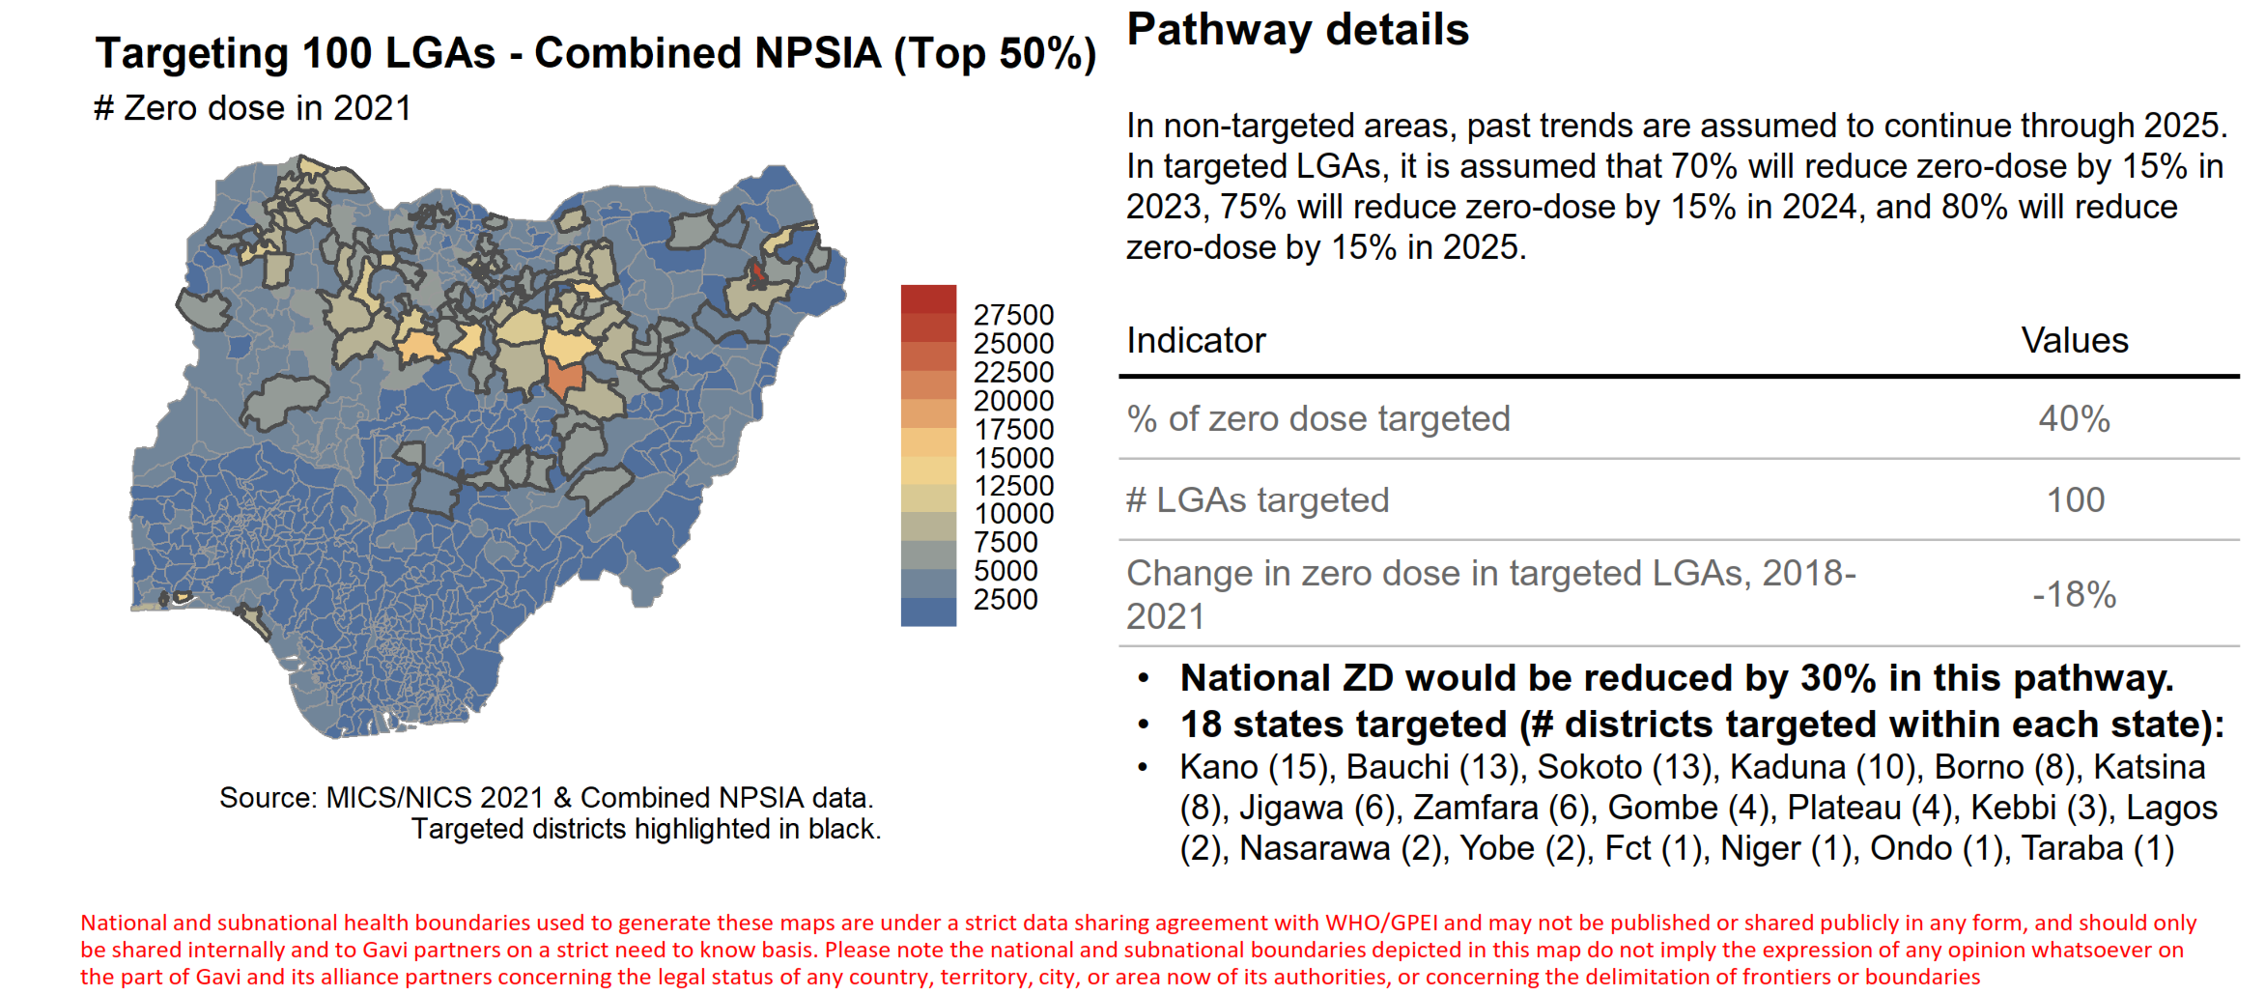
Triangulating District Health Information System (DHIS2) with other data sources to Map Zero-dose Children in Nigeria
Prince Friday¹, Aisha Umar¹, Aminu Mohammed¹, Nchinjoh Sangwe Clovis^{1,2}, Kikelomo Lambo¹ Sulaiman Etamesor³, Yusuf Yusufari⁴, Owens Wiwa¹.
¹Clinton Health Access Initiative.
²Department of Public Health, University of Free State, Bloemfontein, South Africa
³National Primary Healthcare Development Agency.
⁴Bill and Melinda Gates Foundation
BACKGROUND
Fig 2: LGA Prioritization
In 2010, Nigeria adopted the use of web-based software District Health Information System, V.2 (DHIS2) as the platform for the National Health Management Information System. The platform supports real-time data reporting and promotes government ownership and accountability. This platform was instrumental in the mapping and identification of zero-dose children in wards and communities across the country. Recall 2021 WUENIC estimates Nigeria as the second highest with 2.2m ZD children with 30% of surviving infants being zero dose.
100
Yearly DPT3 Coverage of Nigeria compared to some African countries¹
Ethiopia
Following prioritization, Nigeria discovered 100 LGAs across 18 States contributing the highest burden of zero dose namely; Bauchi, Borno, FCT, Gombe, Jigawa, Kaduna, Kano, Katsina, Kebbi, Lagos, NSR, Niger, Ondo, Plateau, Sokoto, Taraba, Yobe and Zamfara
90
Ghana
70
Kenya
Malawi
50
Nigeria
30
10
0
2001
2002
2003
2004
2005
2006
2007
2008
2009
2010
2011
2012
2013
2014
2015
2016
2017
2018
2019
2020
Despite the progress and investments made over the years by the Government and partners, close to 40% of eligible children are still not fully vaccinated
Significant decline in RI coverage due to the COVID-19 pandemic was observed
The current fiscal space further limits the availability of resources for RI
Discussion
The determination of actual zero dose numbers was made possible via DHIS2. Nigeria adopted a practical approach of direct engagement with stakeholders across these LGAs. These engagements with the LGAs led to the development of LGA-specific Z-drop plans and the mapping of resources for implementation.
Additionally, The country is currently promoting a Zero-Dose Learning Agenda aimed at generating evidence on strategies that can be leveraged to successfully identify, enumerate and vaccinate zero-dose children and the missed eligible children in line with the country’s IEV strategy.
Despite the successes, Zero-dose identification and implementation had some limitations e.g Denominator issues, inadequate funding etc
In a bid to address some of the identified challenges, the country has adopted the “Identify, Enumerate and Vaccinate (IEV) Strategy” which will involve H2H enumeration of eligible children and vaccinate them
+23
80
2011 MICS
2013 NDHS
2014 SMART
2015 SMART
2016 MICS/NICS
2018 SMART
2018 NDHS
2019 SMART
2021 MICS/NICS
METHODS
The country reviewed and triangulated numerous potential pathways as well as conducting sensitivity analysis from various sources including DHIS2, MICS/NICS 2021, cVDPV2 case report, Measles outbreak and Geospatial analysis matching them against target population and contextual peculiarities.
LGAs were prioritized based on the scores given to the below indicators and weights:
Identifying
Measles outbreak - 1
cVPV2 Outbreak - 2
cVPV2 Breakthrough – 1
LQAS failure – 1
Vaccinating
Enumerating
DTP0 – 7
DTP3 – 2
MCV0 –3
Coverage scores are only given to only LGAs above median (top 50% percentile)
CONCLUSION
This study highlights the pivotal role played by the District Health Information System, Version 2 (DHIS2), in Nigeria's comprehensive approach to addressing the challenge of zero-dose children. The subsequent deployment of targeted intervention strategies, informed by granular information gathered through DHIS2 has resulted in a significant increase in vaccination coverage among this vulnerable population
When multiple LGAs received the same score, they are further ranked by the number of unimmunized children.
RESULTS
Figure 1. Number of under-1 children
REFERENCES
https://dhis2nigeria.org.ng/dhis/dhis-web-dashboard/#/
https://ngdc.noaa.gov/eog/viirs/index.html
www.worldpop.org .
Figure 2. LGA rank by under-1 population size
Contact Information
Prince Friday.
Senior Associate, New Vaccine Introduction, Capacity Strengthening and Data-use
Clinton Health Access Initiative.
+234-803 482 4002,
pfriday@clintonhealthaccess.org

