Slide 1
Data Quality/Validation and Validation rules Notifications
Part 1 – Building validation rules

Slide 2
Objectives – Bring DQ to the user
Understand the logic behind validation rules
Know how to build validation rules
Incorporate predictors into your validation rules

Slide 3
Main Principal
Send data quality issues to the user.
Data use is low because data trust is low.
Data trust is low because people can not see the DQ issues.
Data quality issues are a feature of the system not a failure.
The failure is not being able to do something about it.
Make it so everyone can see the DQ issues.
Send DQ alerts to where people spent their time:
Email
SMS
Whatsapp
In the alerts tell them what they need to do based upon defined SoPs
Don’t make people guess or figure it out on their own.

Slide 4
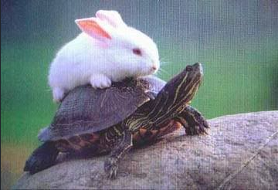
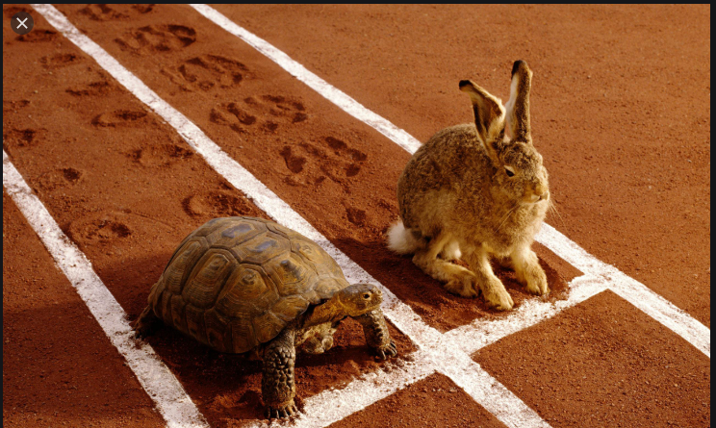
It is not a race. It’s a process.
DQ Issues
DQ Corrections

Slide 5
Understanding the Logic of Validation Rules
A way to assess the quality of Data that have been entered in DHIS2
Based on a set of predefined rules set for the data
This does NOT allow you to FULLY assess whether or not reported numbers are completely accurate

Slide 6
Validation Rules
An expression that defines a relationship between a number of data elements
Expression has Left side, right side and an operator
Common operators are: less than, equal to or greater than
You create Validation Rules based on what you know to be true e.g.
‘Malaria RDT positive’ should always be LESS THAN ‘Malaria RDT tested’

Slide 7
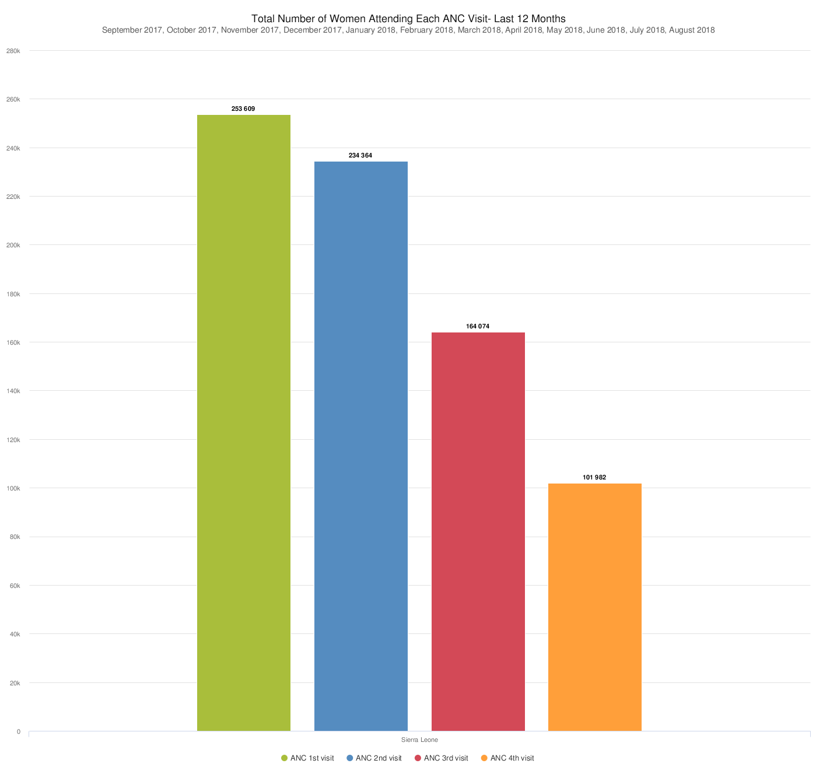
Let’s make an example of a validation rule
What are some possible validation rules?
Let’s make ANC4 <= ANC1

Slide 8
Building Validation Rule: Steps
Make the validation rule
Assign it to a validation rule group
Test the validation rule
Make a validation notification
(Optional) schedule the validation rule group to run automatically
Write protocol and guidlines on how to use validation rule group

Slide 9
Make a validation rule
https://academy.demos.dhis2.org/dq/dhis-web-dashboard/#/

Slide 10
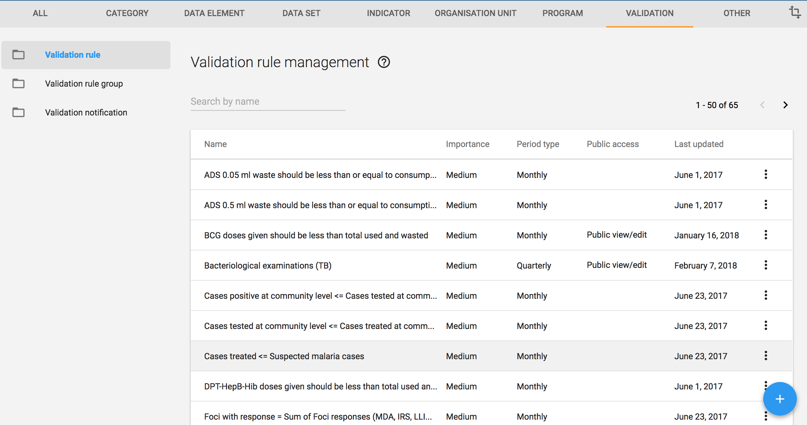
Building Validation Rule
Add New

Slide 11
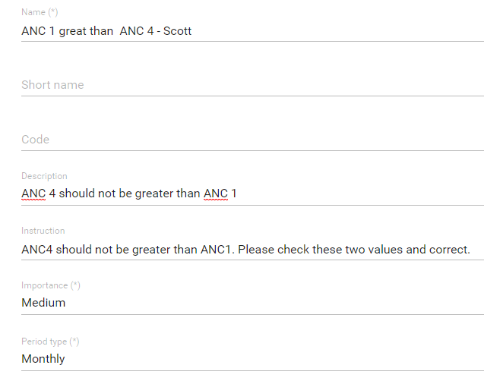
1. Add a name:
ANC 4 <= ANC 1 – YOUR NAME
2. Add description:
ANC4 should not be greater than ANC3.
3. Add instructions:
ANC4 should not be greater than ANC1. Please check these two values and correct.
4. Importance:
Medium (High for things you know to be wrong or disease outbreak)
5. Period type:
Monthly (Should be at least the same as the frequency of data capture)

Slide 12
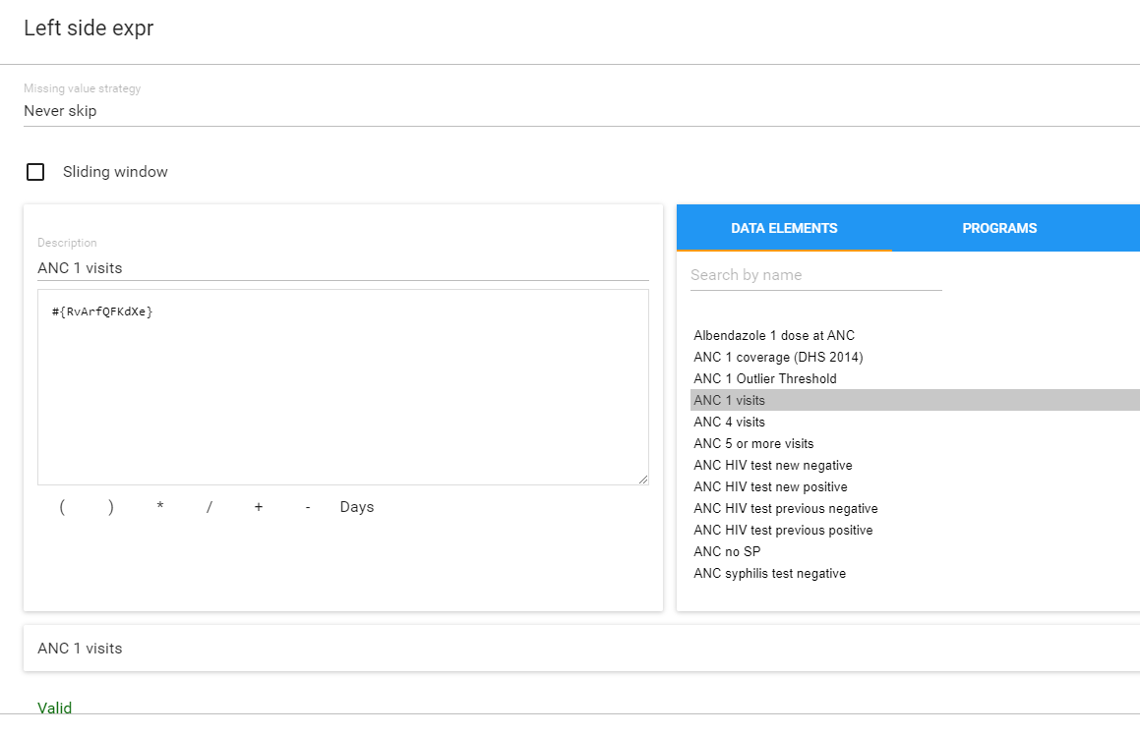
Left Side – ANC 1
Choose Missing value stratigy
-> Select Never Skip

Slide 13
Left Side – ANC 1
Write ‘ANC 1 visits’ for the description
Search ‘ANC 1’
Add ANC 1 visits
Check if equation is valid
Save

Slide 14
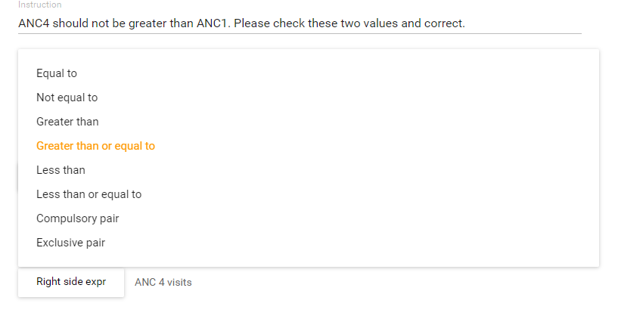
Choose Operator
1. Select ‘Greater than or equal to’

Slide 15
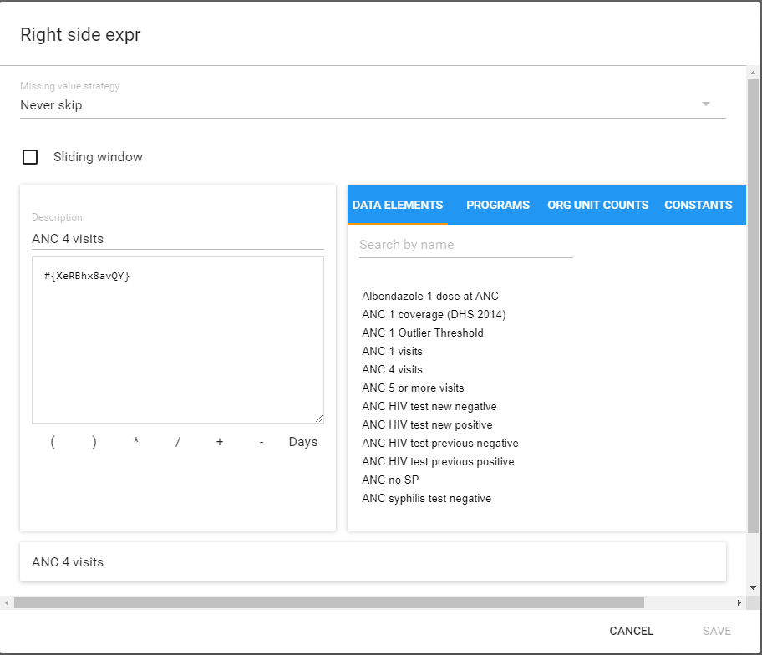
Right Side – ANC 4
Write ‘ANC 4 visits’ for the description
Search ANC 4 visits
Add ANC 4 visits
Equation is valid
Save

Slide 16
Save the validation rule
Org. Unit levels – Sets the level that the validation rule will run for. Nothing selected means that it will run for the org unit level for which the data was captured.
Skip this rule during form validation will not notify the user during data capture if the rule is triggered
Save

Slide 17
Creating Validation Rules & Group
Once you have created a set of validation rules, you need to put them in groups e.g. malaria for ease of analysis
This group is what you will select in your Validation Rule Analysis
The output will test every rule in the Group and show you EVERY TIME a rule was violated within your specified time and place!
Notes:
****Change to demo and put in trainer's guide

Slide 18
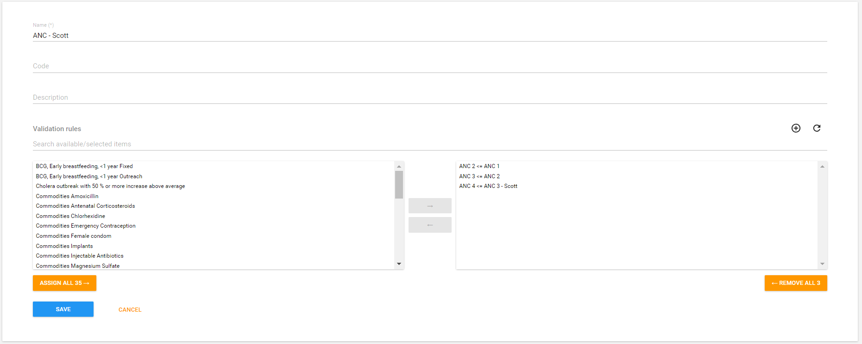
Making the validation rule group: ANC – YOUR NAME

Slide 19
Using Predictors in Validation Rules
A predictor is a value calculated from previously reported values.
EX: Average Malaria incidence over the last 6 months.
EX: Average monthly ART consumption over the last 3 months.
EX: Average ANC 1 Visits with 3 standard deviation for the last 12 months – ANC 1 Outlier Threshold
If this value is 0 then count 1 – Count the number of facilities that reported some value.

Slide 20
Warning!
Predictors are a scheduled job that consume a lot of server resources when run.
Do not run predictors during peak server usage hours
Do not use predictors is you have any serve issues at all.
Do not use predictors if you have limited storage, CPUs, or ram.

Slide 21
How to make a pridictor
Make a data element to store the pridicted value
Make the pridictor
Put the pridictor in a pridictor group
Schedule the pridictor group to run
Put the pridictor in a validation rule

Slide 22
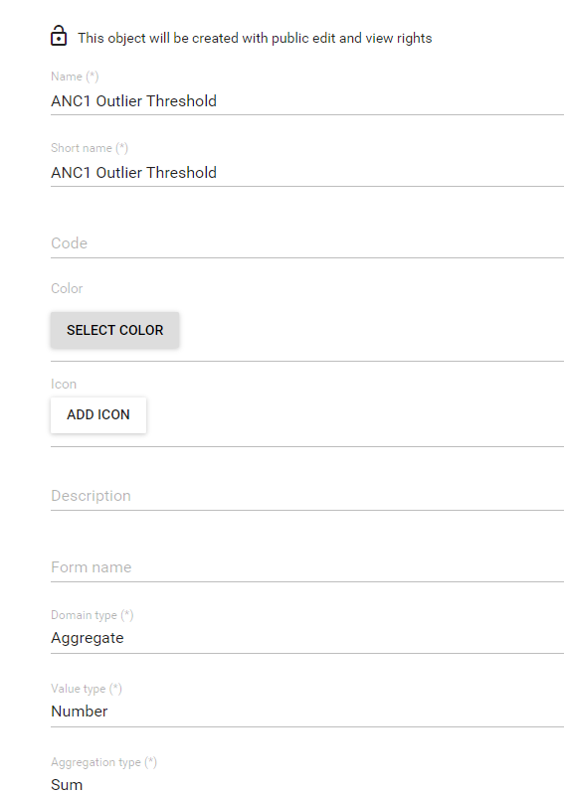
Create outlier threshold data element
Name – ANC 1 Outlier Threshold – *Your Name*
Short name – Same
Domain type – Aggregate
Value type – Number
Aggregation type - Sum

Slide 23
Make the predictor
Name – ANC 1 Outlier Threshold
Define output DE – ANC 1 Outlier Threshold
Select Org unit level - Facility

Slide 24
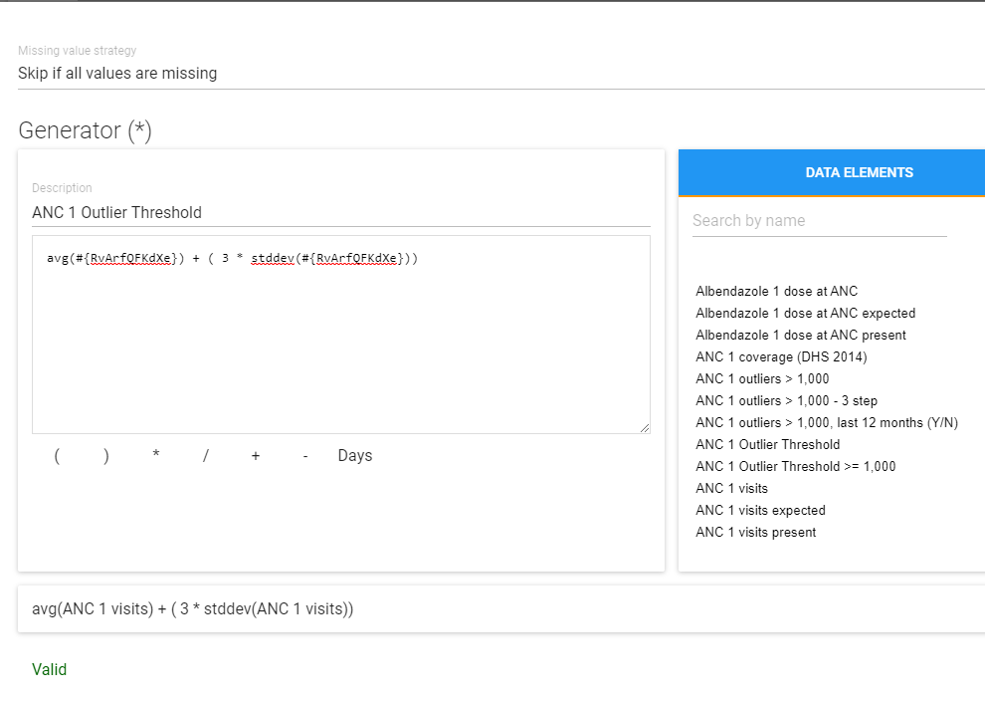
Define generator
Select missing value stratigy: Skip if all values are missing.
Default is skip is any is missing? Is this good for this?
No, we want the caluclation even if there are missing values.

Slide 25
Define generator
2. Name – ANC 1 Outlier Threshold
2. Formula – avg(ANC1 UID) + (3 * STDDEV(ANC1 UID))

Slide 26
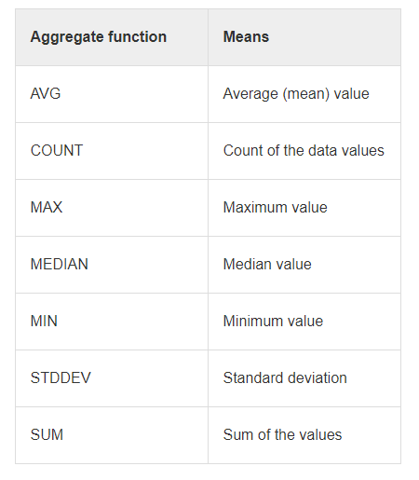
Other fuctions for predictors
BE AWARE: the functions are case sensitivie.
THEY MUST BE IN LOWER CASE/SMALL LETTERS
EX: avg, count, max, median, min, stddev

Slide 27
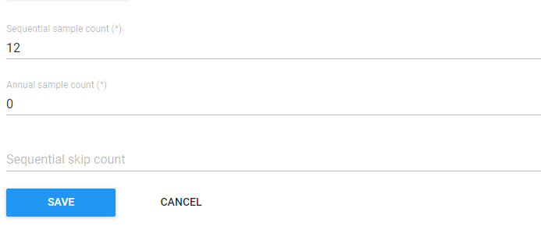
Define couts
Sequential sample count – 12
Annual sample count 0
Sequential skip count 0

Slide 28
Sequential – 12, Annual – 0, Skip - 0
1 2 3 4 5 6 7 8 9 10 11 12 1 2 3 4
X
Used in calculation

Slide 29
Sample count for seasonsal data – Malaria
Sequential sample count is = 4
Annual sample count is = 2
Total sampled period is 22 =
4 previous weeks
+ 8 weeks from the previous weeks over the last two years
+ 8 weeks from the period weeks over the last two years
+ 2 week 9 from the last two years

Slide 30
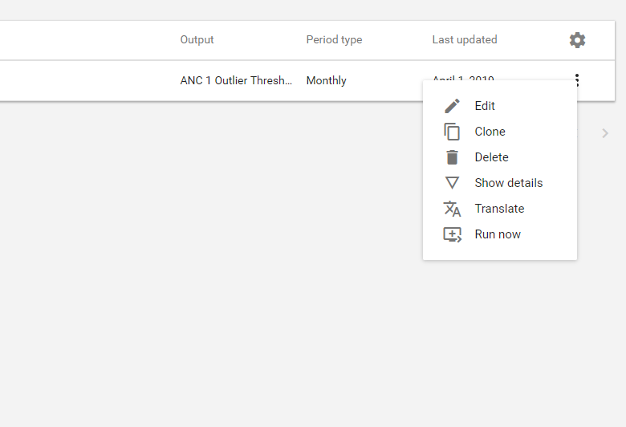

Slide 31
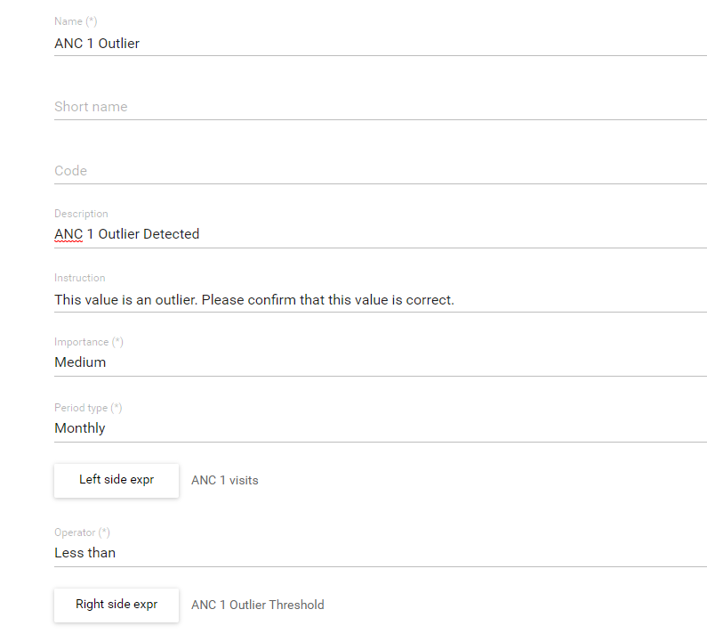
Outlier Threshold in to validation rule
Name
Description
Instruction
Importance
Period type
Left side – ANC 1 Visits
Operator – Less than
Right side – ANC 1 Outlier Threshold

Slide 32
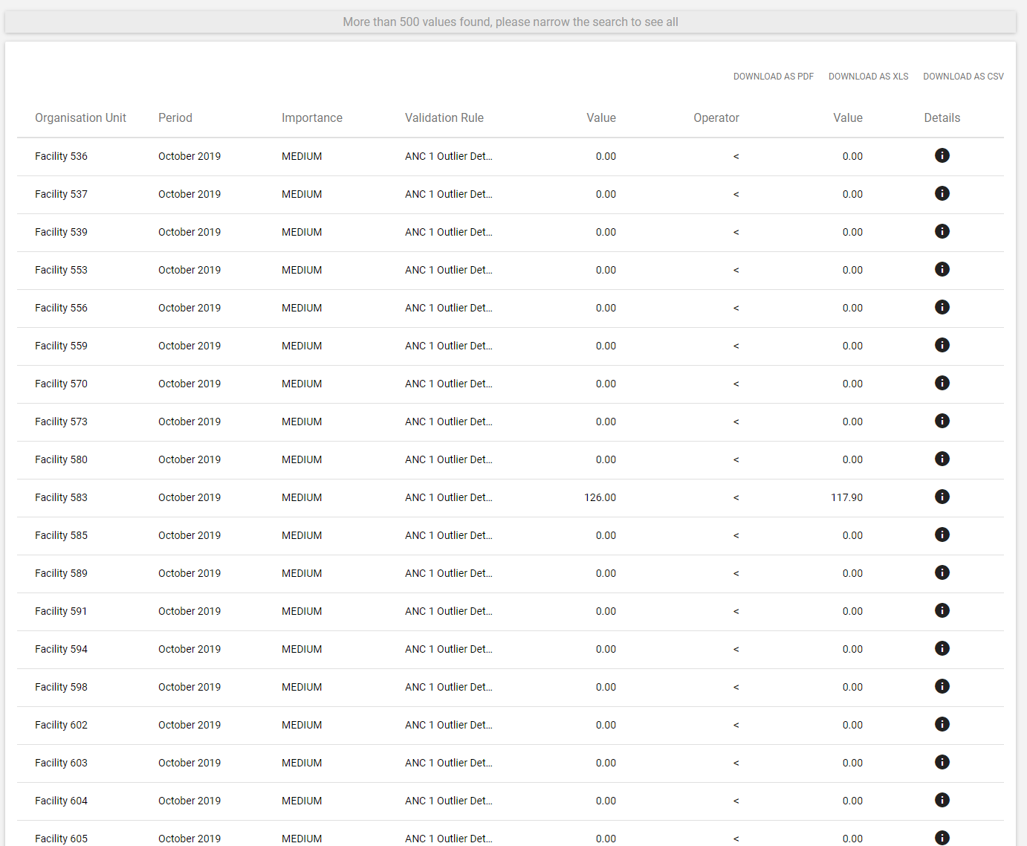
Last Step
Add it to a validation rule group and run it:

Slide 33
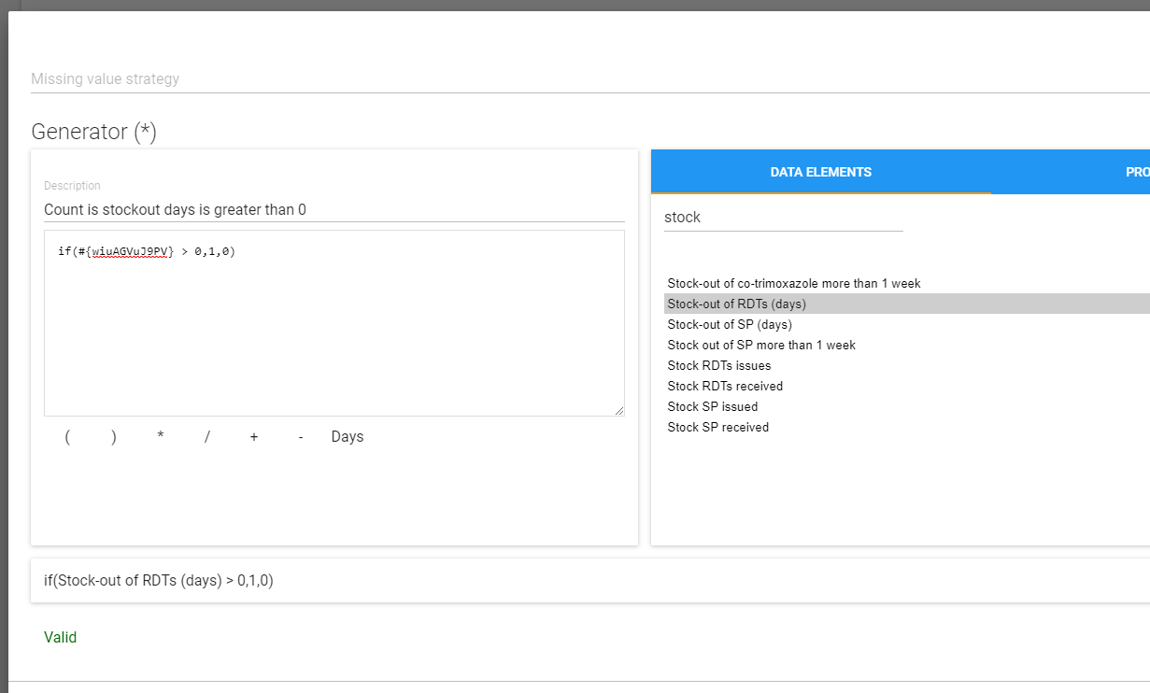
Counting Org. Units Using Predictors
Example: I want to know all of the org units the recorded a positive value for the number of stock-out days.
Translation: If days of stockout is greater than o than record a 1 if not record a 0

