Slide 1
Data Quality/Validation and Validation rules Notifications
Part 2 – Running and scheduling validation rules

Slide 2
Objectives
Learning Objectives
Be able to set up validation rules notifications
Be able to run validation rule analysis
Be able to schedule validation rules to run automatically

Slide 3
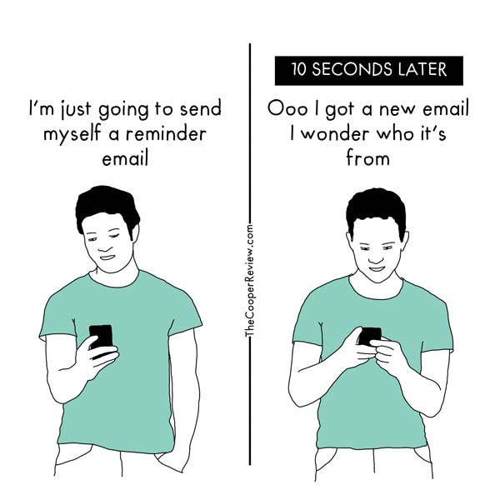
Our email is everything.

Slide 4
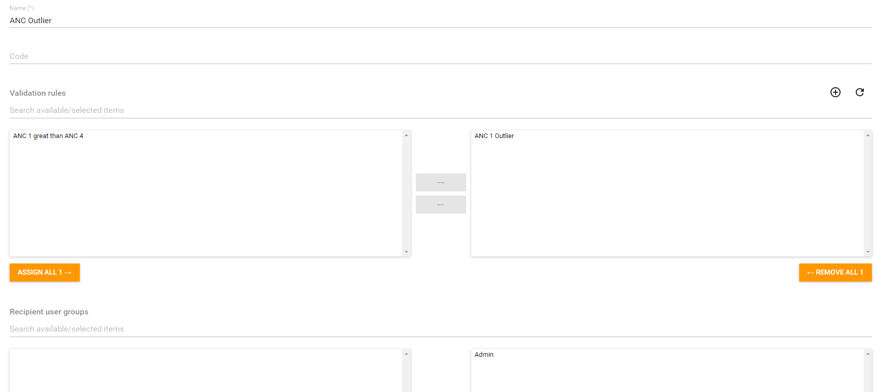
Make validation rule notification

Slide 5
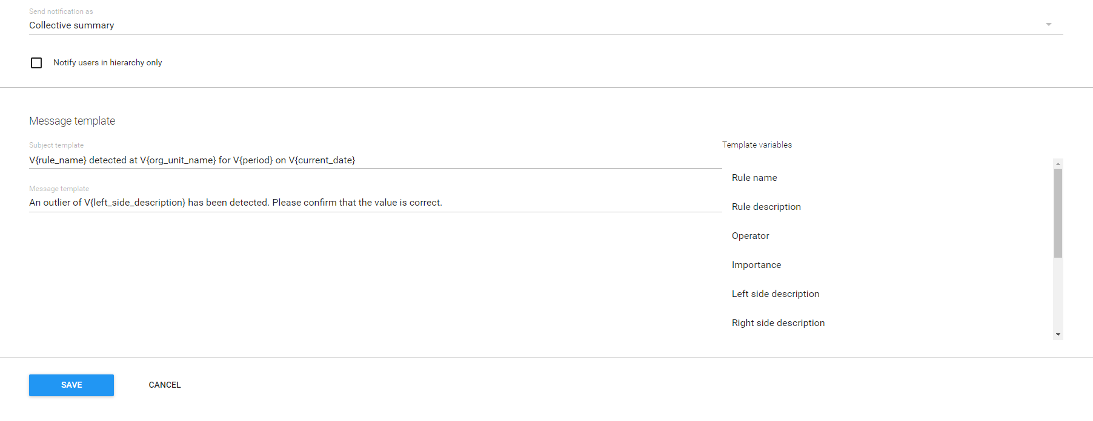
Make validation rule notification

Slide 6
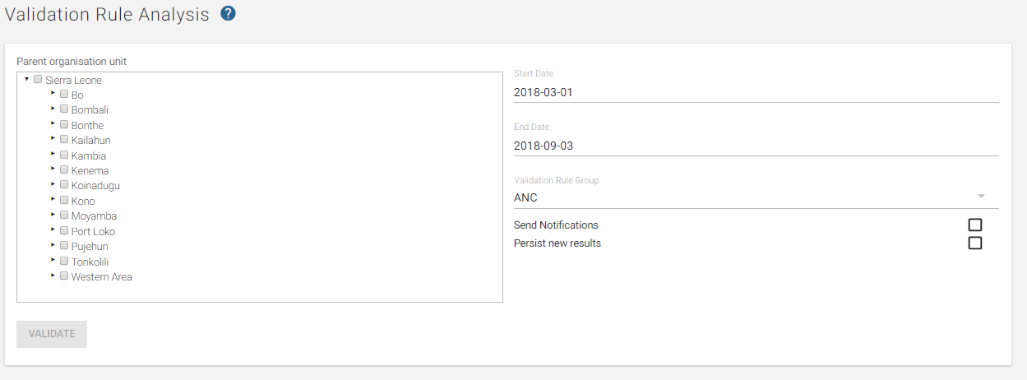
Running Validation Rule Analysis: Finding WHERE to do this

Slide 7
Validation Rule Analysis
1. Select your organisational units
Selecting the whole country may return hundreds of alerts (and takes a while and may crash the system)

Slide 8
Validation Rule Analysis
2. Select your date range
Selecting a large date range may return hundreds of alerts.

Slide 9
Validation Rule Analysis
3. Select your validation rule group

Slide 10
Validation Rule Analysis
4. Choose if you want to send notifications
Will send notifications as defined by the validation notification
Nothing will be sent if there are not configured notifications

Slide 11
Validation Rule Analysis
5. Select if you would like to presist new results
This will save the results of the validation rule analysis. Saved results can then be accessed via the API. Becomes more important when we talk about scheduling validation rules

Slide 12
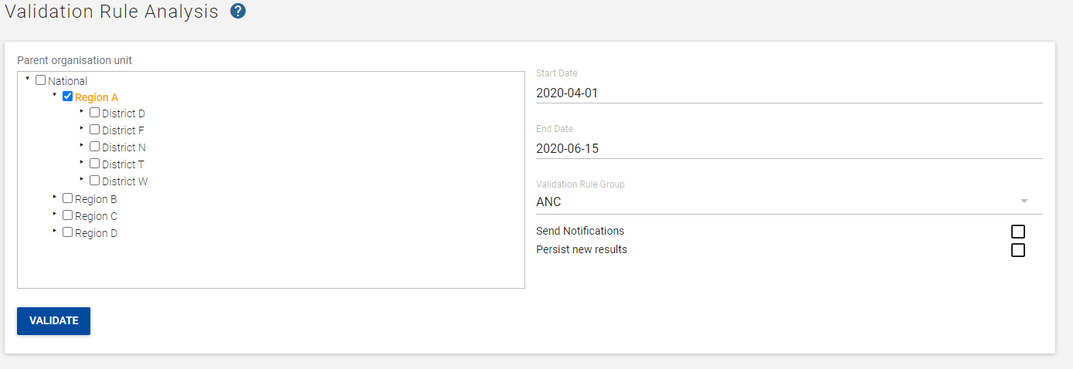
Running Validation Rule Analysis Finding out HOW to do this
Start Date: April 1
End Date: Today
Validation Rule Group: ANC
Organisation unit: Region A
Click Validate

Slide 13
Demo
https://academy.demos.dhis2.org/dq

Slide 14
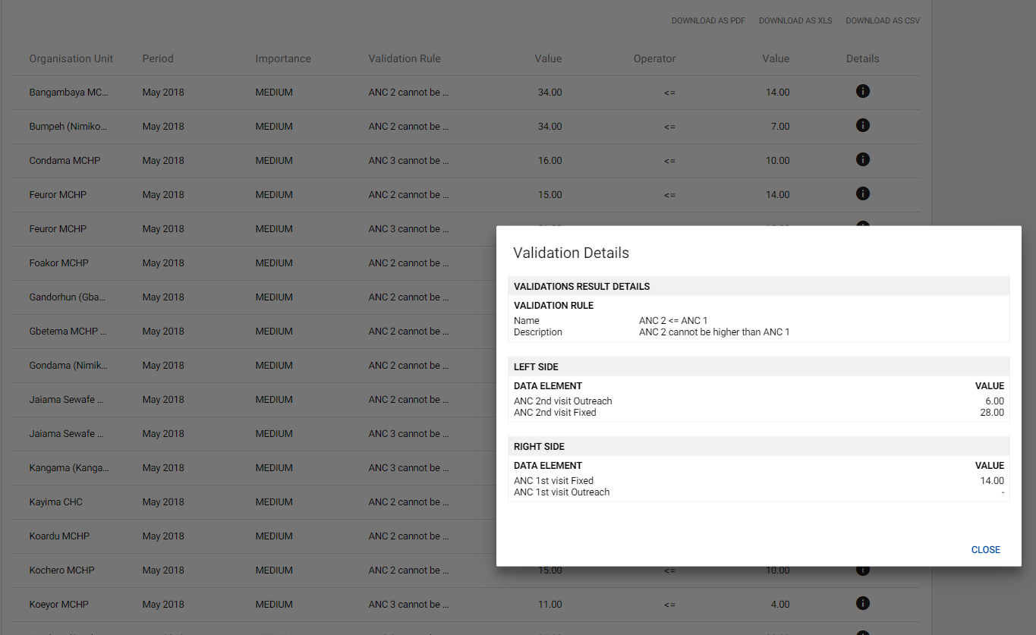
Running Validation Rule Analysis Seeing the results

Slide 15
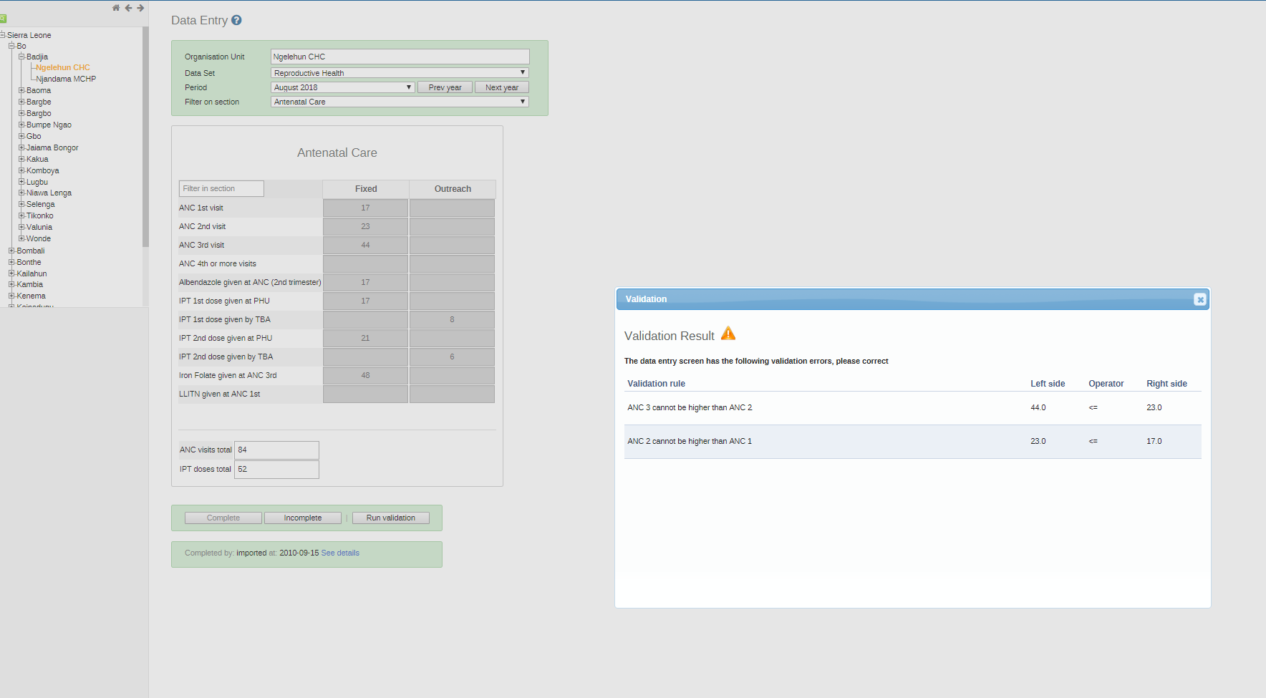
When to run validation rules:
Validation rules can run automatically or manually during data entry

Slide 16
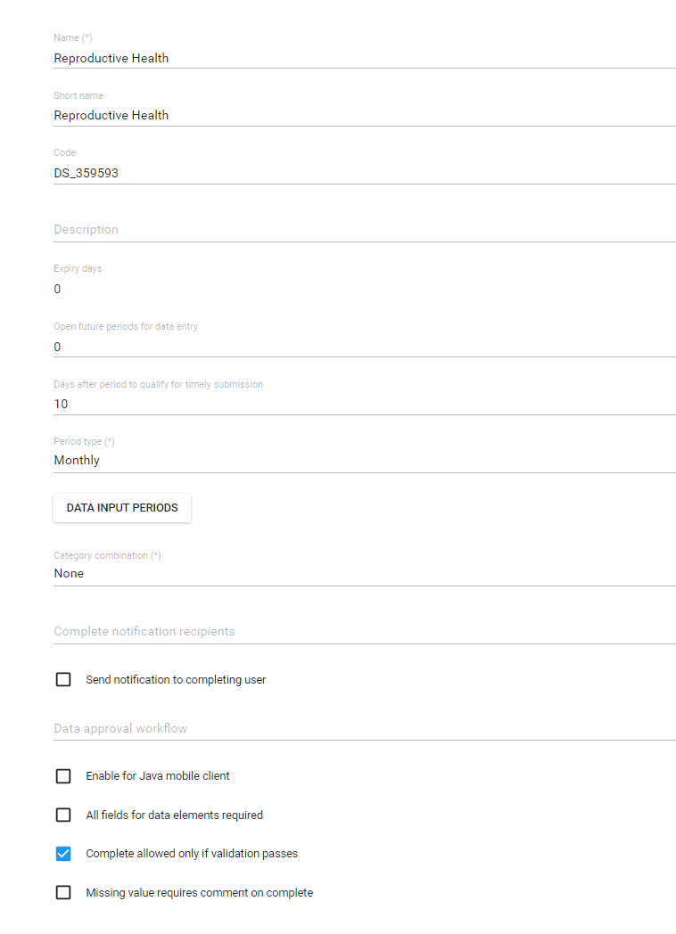
When to run validation rules:
Validation rules to prevent data completion
This can cause confusion, frustration, and hurt reporting completeness
When to do this:
Validation rules are well formed, tested, and verified
For well trained district or higher officers
Not for community health workers or poorly trained staff.

Slide 17
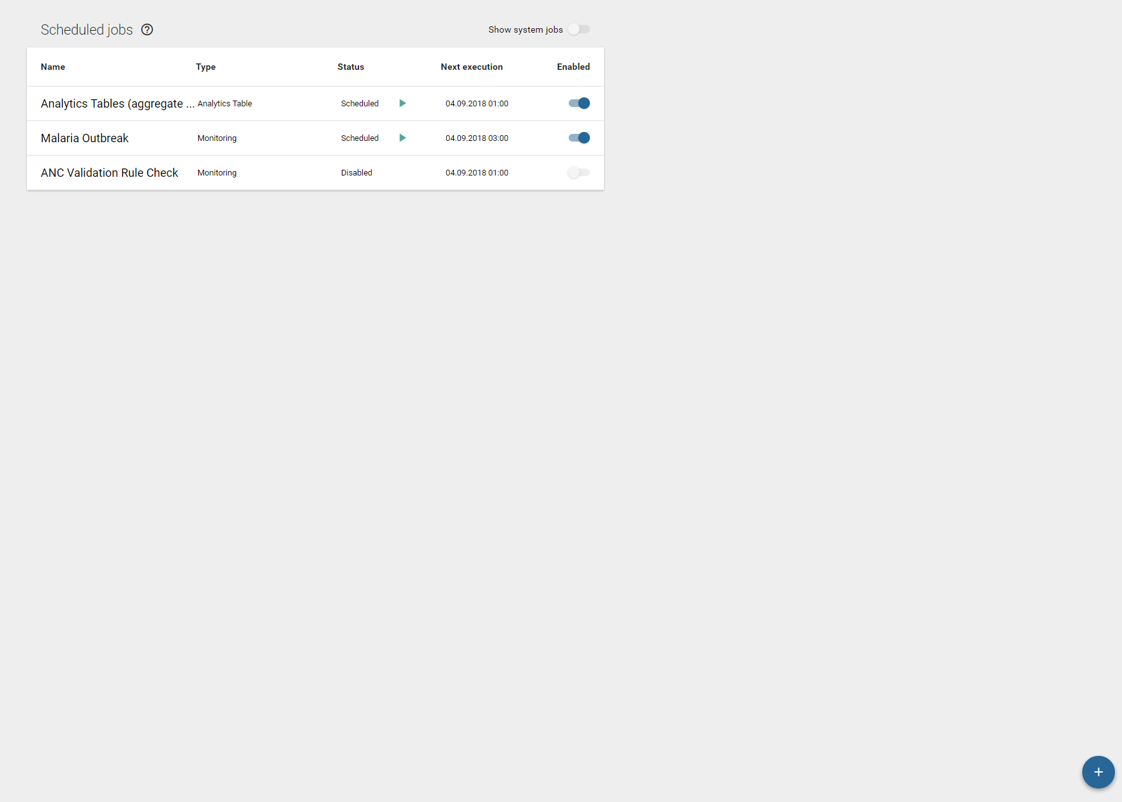
When to run validation rules: Automatically scheduled
Use scheduling app to make a new ‘monitoring job’

Slide 18
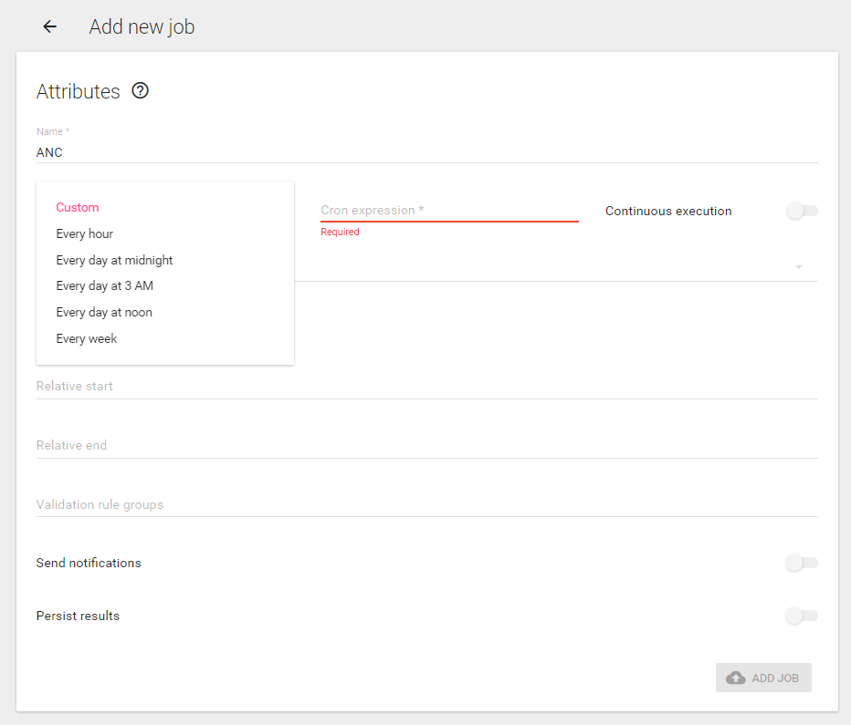
When to run validation rules: Automatically scheduled
Choose a premade frequency
OR
Write a custom cron expression
OR
Continuous expression – will constantly be running. Good if using for disease surviallance. Bad for many validation rules over long period

Slide 19
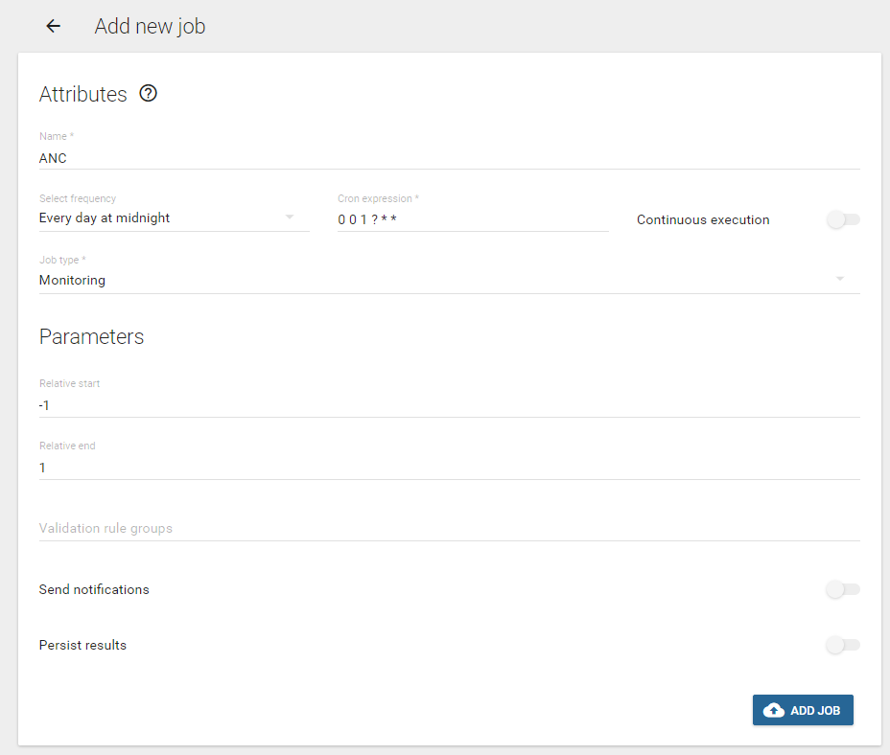
When to run validation rules: Automatically scheduled
The number of days in the past to run the validation rules for.
The number of days in the future to run the validation rules for.
-1 was yesterday and +1 is tomorrow; therefor, any data entered for any period that covers yesterday through tomorrow.
3 days
1 month, quarter, year, etc.

Slide 20
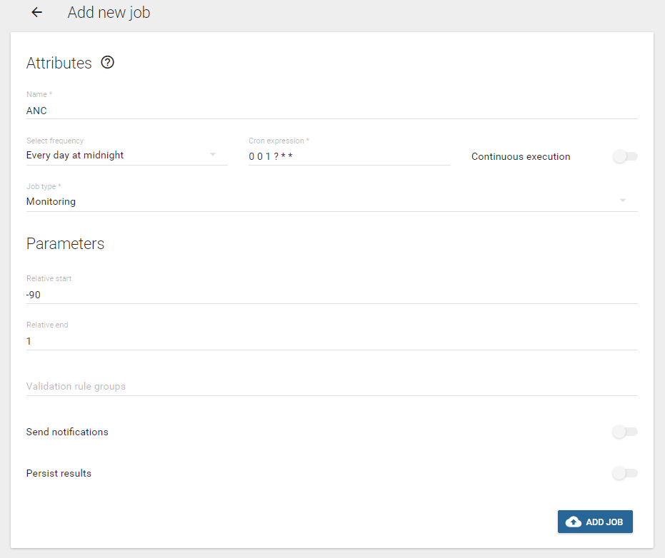
When to run validation rules: Automatically scheduled
-90 days is: March 24th
+1 day is: tomorrow
Between March 24th and tomorrow there is
91 days
4 months (including March.)
2 quarters
1 year

Slide 21
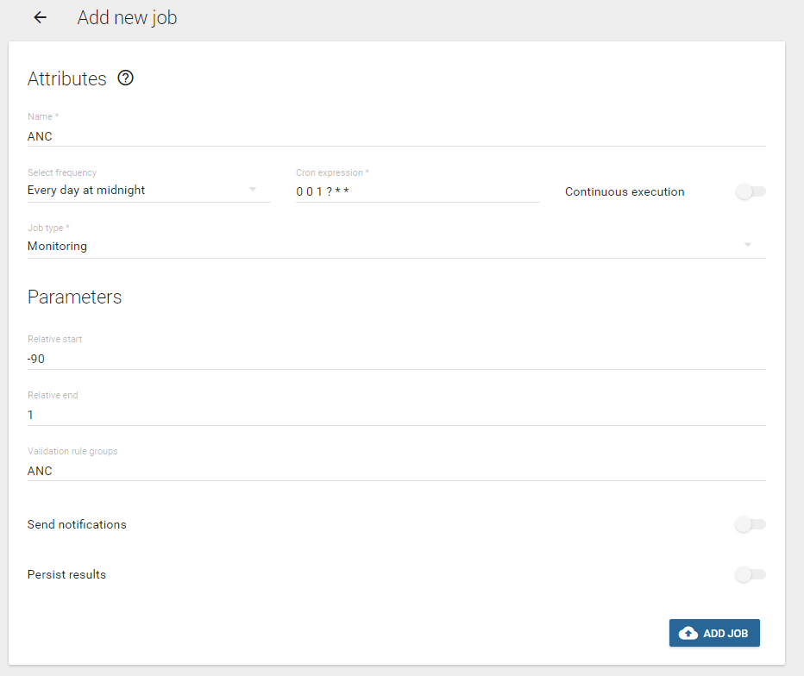
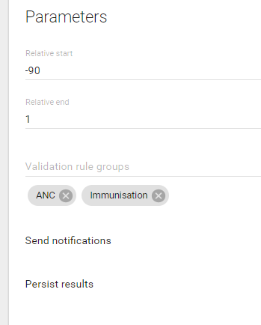
When to run validation rules: Automatically scheduled
Choose validation rule groups by typing and selecting
More than one can be selected

Slide 22
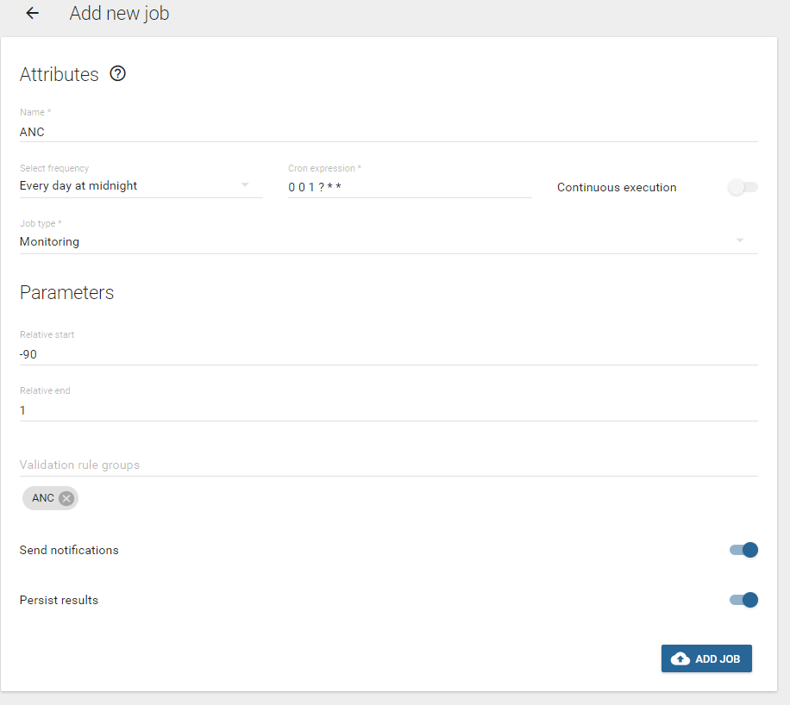
When to run validation rules: Automatically scheduled
Will automatically send notifications via email and sms if:
notifications are configured
email server is configured
sms gateway is configured
user is configured to recieve emails and sms

Slide 23
When to run validation rules: Automatically scheduled
Will ‘persist’ or save results, so that only new validation alerts are produced if they are detected.
No one wants to recieve the same validation rule alerts everyday.
Warning: could take up a lot of server space if you are persisting a lot of validation rules.

Slide 24
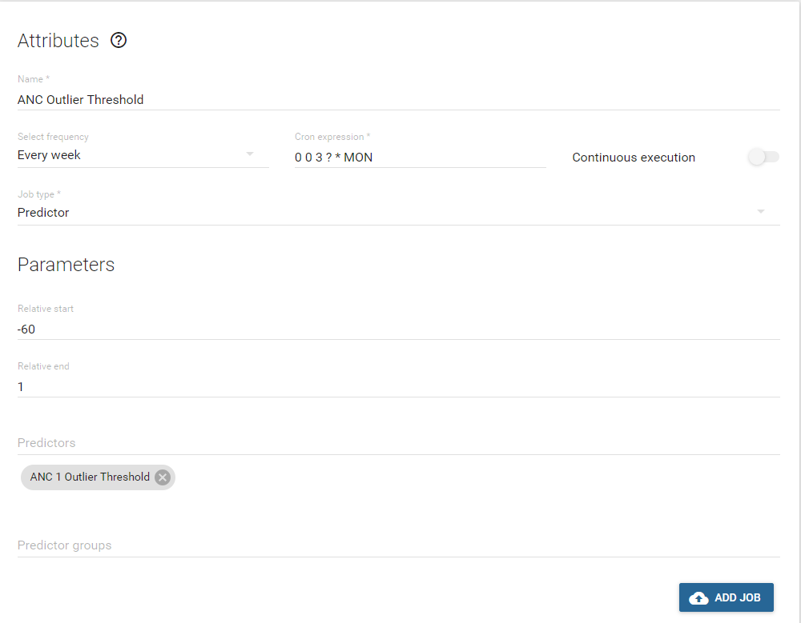
Scheduling predictor
Name
Select frequency: Every week
Job type: Predictor
Relative start: -60
Relative end: - 1

Slide 25
When to run validation rules: Automatically scheduled
A couple of best practices:
Schedule predictors to run before analytics tables
Schedule analytics tables before validation rules
Schedule just a few critical validations to run nighly or more frequently – disease surveillance and persist results
Schedule more, routine DQ checks to run weekly, monthly, or less frequently and make the relative period short: Start relative period = -20 and End relative period = 1
Scheduling Running
Predictors – 23:00 SUNDAY
Analytics tables – 24:00 SUNDAY
Validation Rules Alers – 03:00 Daily

Slide 26
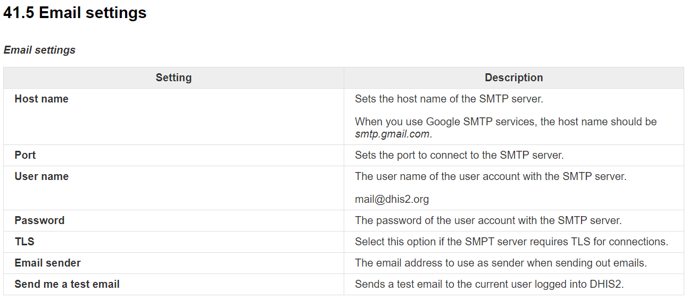
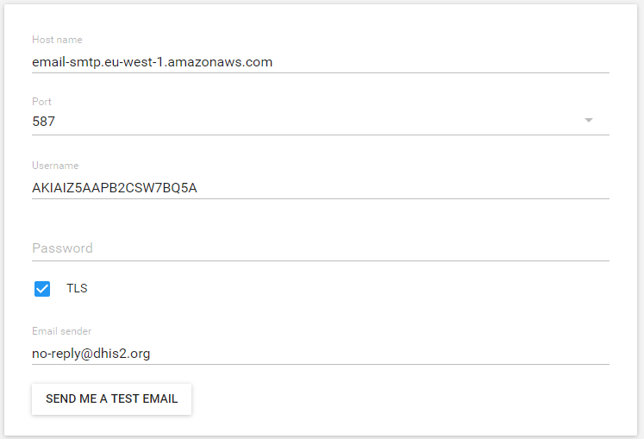
About Email – Get the information from your email host.

Slide 27
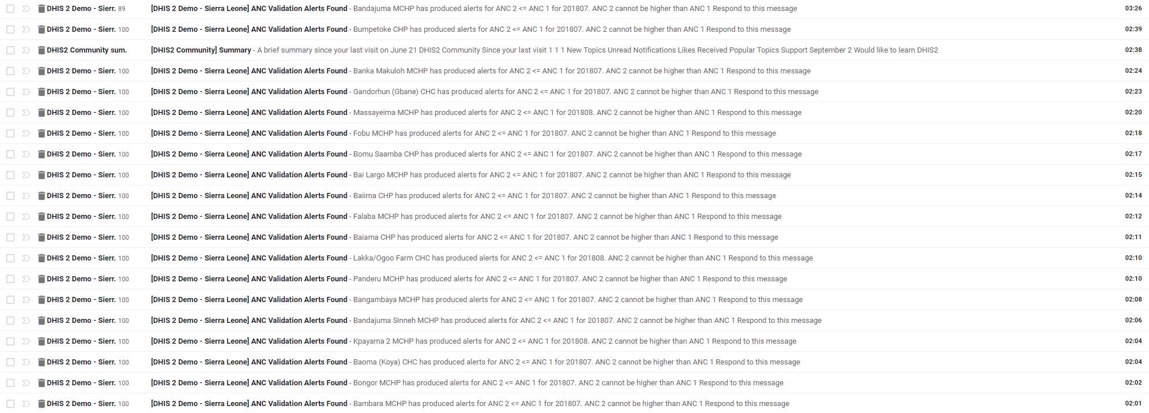
Automatic email alerts
Daily validation rule alert emails for ANC for whole country
2 validation rules makes:
19 emails
Approximatly 2000 alerts.
USEFUL??

Slide 28
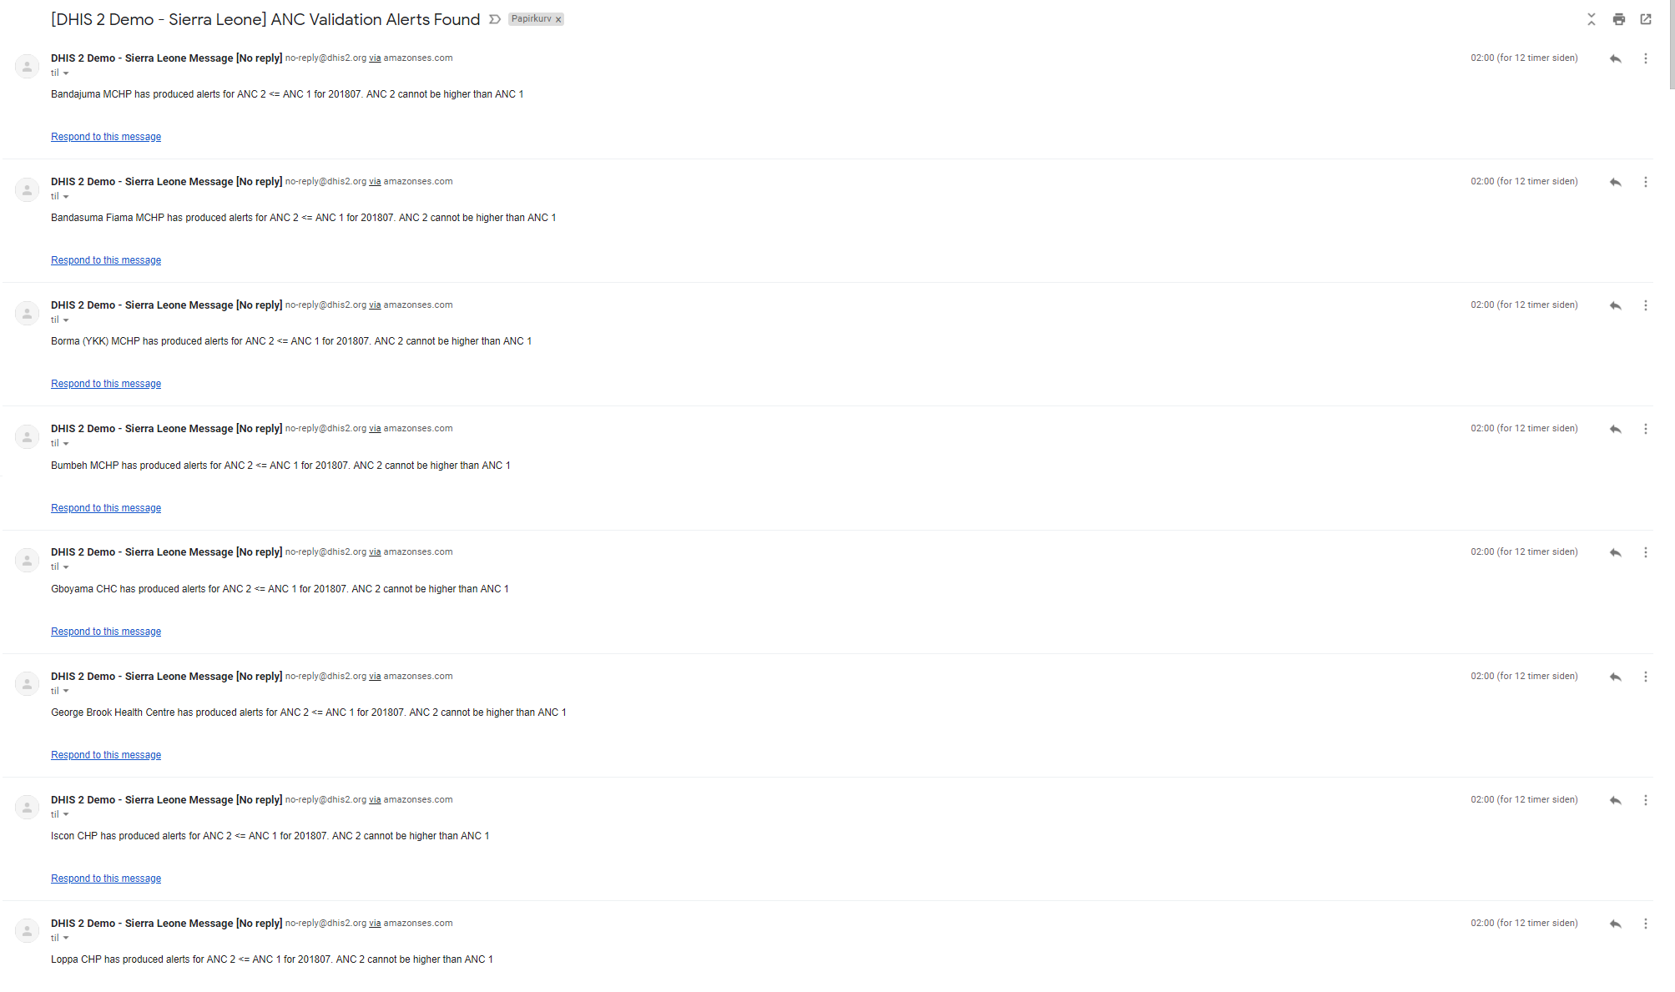
Automatic email alerts
Daily validation rule alert emails for ANC for whole country
2 validation rules makes:
19 emails
Approximatly 2000 alerts.
USEFUL?? NO

Slide 29
Example
https://mail.google.com/mail/u/1/#inbox/FMfcgxwHNqJFFxkGbfzBWBxqxWSfmWxC

Slide 30
How and for whom can automatic validation email alerts be useful?
From: "Rwanda HMIS Message [No reply]" <trainmutali@gmail.com> Date: June 6, 2019 at 10:00:00 PM PDT To: Undisclosed recipients: ; Subject: [Rwanda HMIS] Validation violations as of 2019-06-07T07:00:00 Violations: High 23, medium 0, low 0 A violation of the Penta 3 outlier data validation rule was detected at Batsinda HP for 201905 on 20 Please confirm that the value is correct of Penta 3 A violation of the Penta 3 outlier data validation rule was detected at Bumbogo (ex-Gikomero I) CS f Please confirm that the value is correct of Penta 3 A violation of the Penta 3 outlier data validation rule was detected at Cyuga HP for 201905 on 2019- Please confirm that the value is correct of Penta 3 A violation of the Penta 3 outlier data validation rule was detected at Cyumba CS for 201905 on 2019 Please confirm that the value is correct of Penta 3 A violation of the Penta 3 outlier data validation rule was detected at Gatsata CS for 201905 on 201 Please confirm that the value is correct of Penta 3 A violation of the Penta 3 outlier data validation rule was detected at Gikore CS for 201905 on 2019 Please confirm that the value is correct of Penta 3 A violation of the Penta 3 outlier data validation rule was detected at Gitarama CS for 201905 on 20 Please confirm that the value is correct of Penta 3 A violation of the Penta 3 outlier data validation rule was detected at Gitwe CS for 201905 on 2019- Please confirm that the value is correct of Penta 3 A violation of the Penta 3 outlier data validation rule was detected at Harmony Clin for 201905 on 2 Please confirm that the value is correct of Penta 3 A violation of the Penta 3 outlier data validation rule was detected at Jenda (nyabihu) HP for 20190 Please confirm that the value is correct of Penta 3 A violation of the Penta 3 outlier data validation rule was detected at Kirambi CS for 201905 on 201 Please confirm that the value is correct of Penta 3 A violation of the Penta 3 outlier data validation rule was detected at Kirarambogo CS for 201905 on Please confirm that the value is correct of Penta 3 A violation of the Penta 3 outlier data validation rule was detected at Ntoma CS for 201905 on 2019- Please confirm that the value is correct of Penta 3 A violation of the Penta 3 outlier data validation rule was detected at Nyarugunga CS for 201905 on Please confirm that the value is correct of Penta 3 A violation of the Penta 3 outlier data validation rule was detected at Rubengera CS for 201905 on 2 Please confirm that the value is correct of Penta 3 A violation of the Penta 3 outlier data validation rule was detected at Ruheru CS for 201905 on 2019 Please confirm that the value is correct of Penta 3 A violation of the Penta 3 outlier data validation rule was detected at Rusizi CS for 201905 on 2019 Please confirm that the value is correct of Penta 3 A violation of the Penta 3 outlier data validation rule was detected at Rutare (gicumbi) CS for 2019 Please confirm that the value is correct of Penta 3 A violation of the Penta 3 outlier data validation rule was detected at Rutonde CS for 201905 on 201 Please confirm that the value is correct of Penta 3 A violation of the Penta 3 outlier data validation rule was detected at Rwimitereri CS for 201905 on Please confirm that the value is correct of Penta 3 A violation of the Penta 3 outlier data validation rule was detected at Sovu (Ngororero) CS for 2019 Please confirm that the value is correct of Penta 3 A violation of the Penta 3 outlier data validation rule was detected at St Pierre DISP for 201905 on Please confirm that the value is correct of Penta 3 A violation of the Penta 3 outlier data validation rule was detected at Tare CS for 201905 on 2019-0 Please confirm that the value is correct of Penta 3

Slide 31
Data Quality SoPs
Defines what actions to take by everyone.
What is the process for each person
What automated messages does each person recieve
User groups for messages
Org unit contact details are updated

Slide 32
Data Quality
Completeness
Accuracy
Integrity
Timeliness
01
02
03
04
All data fields are completed
Data reported should be same as source docs
Data without personal manipulation
Data to be prepared and sent on time
Two types of DQAs:
Central Level: Integrated supportive supervision (conducted every 6 months)
Programs specific data coordination meetings
Data entry validation rules(Logical validation rules)
HMIS analysis and feedback
Dataset locking and approval
Perfomance Based Financing and Accreditation standards
Decentralized Level: Facilities are responsible for conducting DQAs at lower level facilities within their catchment areas

Slide 33
Rwanda - Developed Tools in Data management
SOPS
Data management and reporting SOP
Data validations SOP
Data collection tools
Patient Files
Registers
Reporting Forms
Indicator Reference Manual (Metadata Dictionary)

Slide 34
M&E Structure
M&E officers
Data managers
IT programmers
Statisticians
MoH & RBC
Referral & Provincial Hospitals
(11)
Data managers/ statisticians
M&E officers
District Hospitals
(36)
Data manager
Head of HC
Health Centers
(499)
Nurse
Health Posts
(406)
Community Health Workers
(45,516)
CHW

