Slide 1
Feature Spotlight – Aggregate Data Entry App
January 22, 2025
David Kennedy – DHIS2 Product Manager

Slide 2
Welcome
This is the first of our new webinar of the series we are calling Feature Spotlight
The new user interface will be reviewed, its new feature set will be demonstrated and discussions regarding how forms are rendered within the app will be covered.
Upcoming Feature Spotlight Webinars
Capture app | Feb 5
Line Listing app | Feb 19
Android Analytics | March 5
Notes:
Feature spotlights are about having a closer look at some recent features that may have been around for a few releases but there is some interest in

Slide 3
Agenda
Welcome (5 minutes)
Introduction to the Aggregate Data Entry App (15 minutes)
Validation and other details (5 minutes)
Form Configuration (20 minutes)
Custom Forms (5 minutes)
What's next (5 minutes)

Slide 4
New aggregate data entry app release
Notes:
https://test.real.dhis2.org/v41/

Slide 5
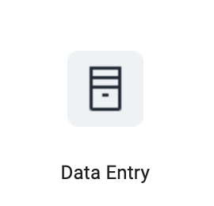
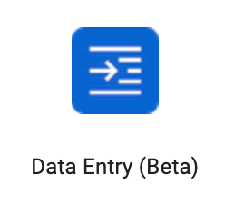
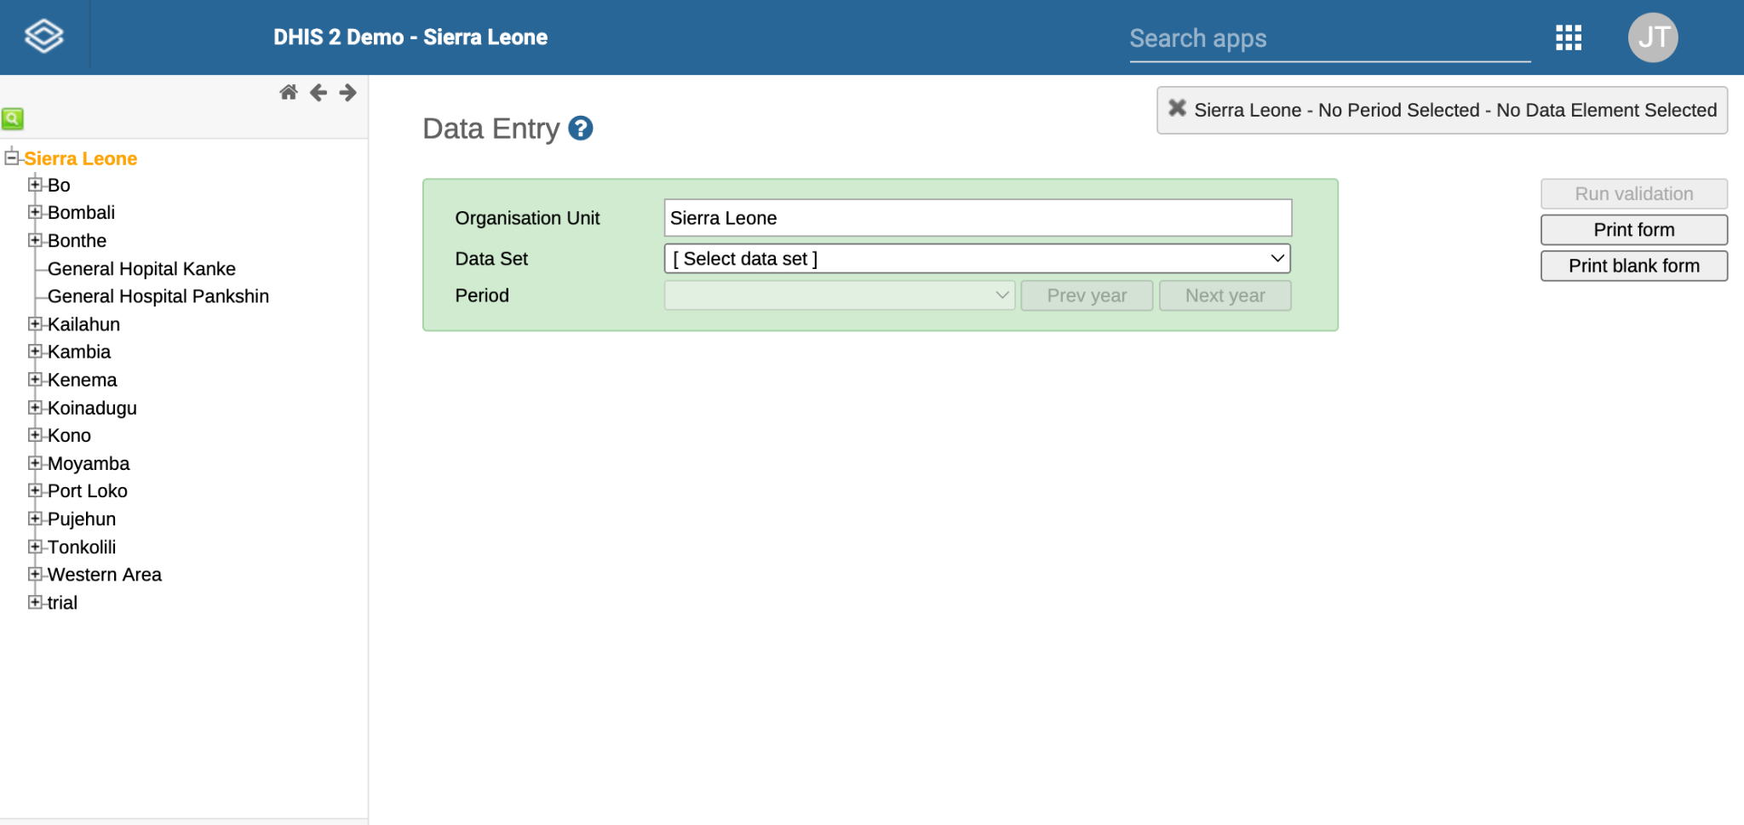
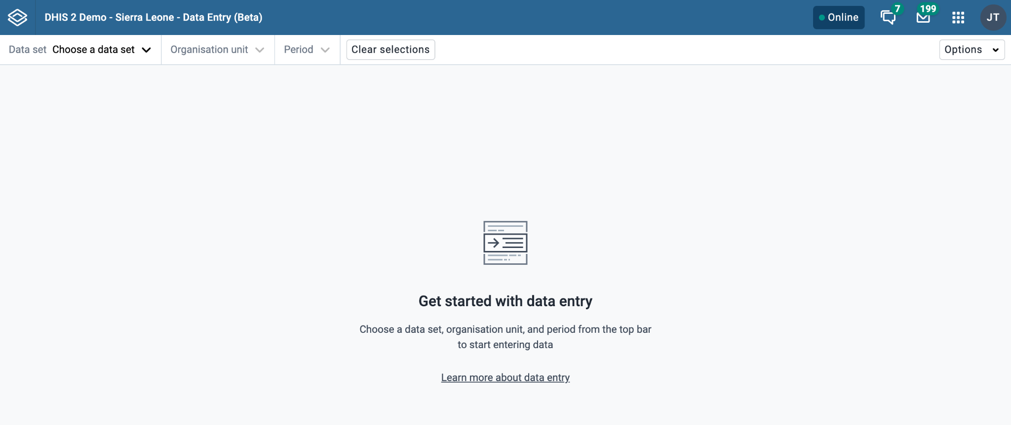
Data Entry (Legacy)
Data Entry

Slide 6
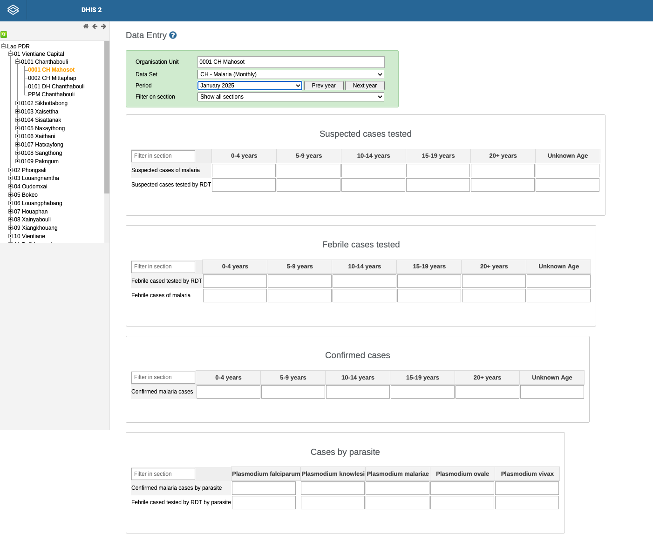
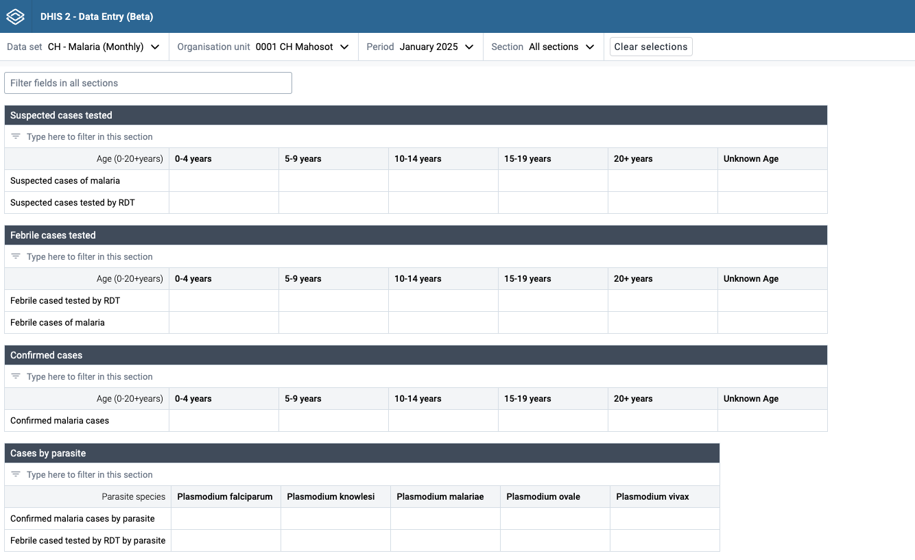
Same, but different
Notes:
Still have to first select the context for the data to be collected, Data set, Org unit and period
Now you select the dataset first instead of the org unit
Sample text for below
Criteria for Suspected Cases: Identify patients exhibiting signs of malaria based on the set criteria.
Verify Entries: Double-check entries for completeness and correctness.
Cross-Check Age Groups: Make sure each suspect and tested case is logged under the correct age group.

Slide 7
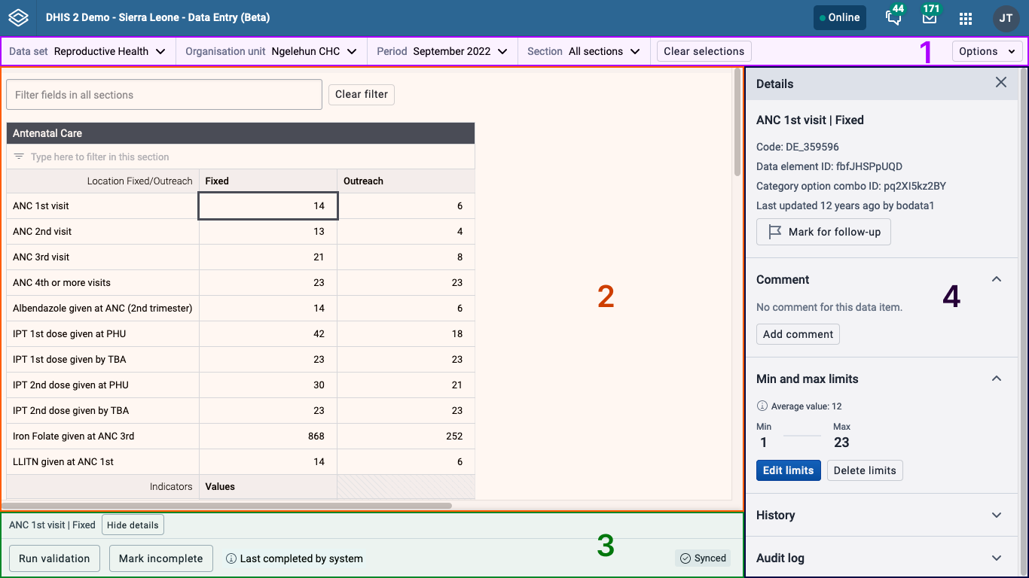
Screen layout
Notes:
Top bar: the top bar is where you choose from the different options to open a data entry form. You can always use the top bar to change or reset your choices.
Data workspace: the data workspace is where you work with a data entry form.
Bottom bar: the bottom bar offers actions and more information about the form you're working on.
Details sidebar: the details sidebar is where you can see more information about data values and see validation results. The details sidebar can be opened and closed as you work and is closed by default.

Slide 8
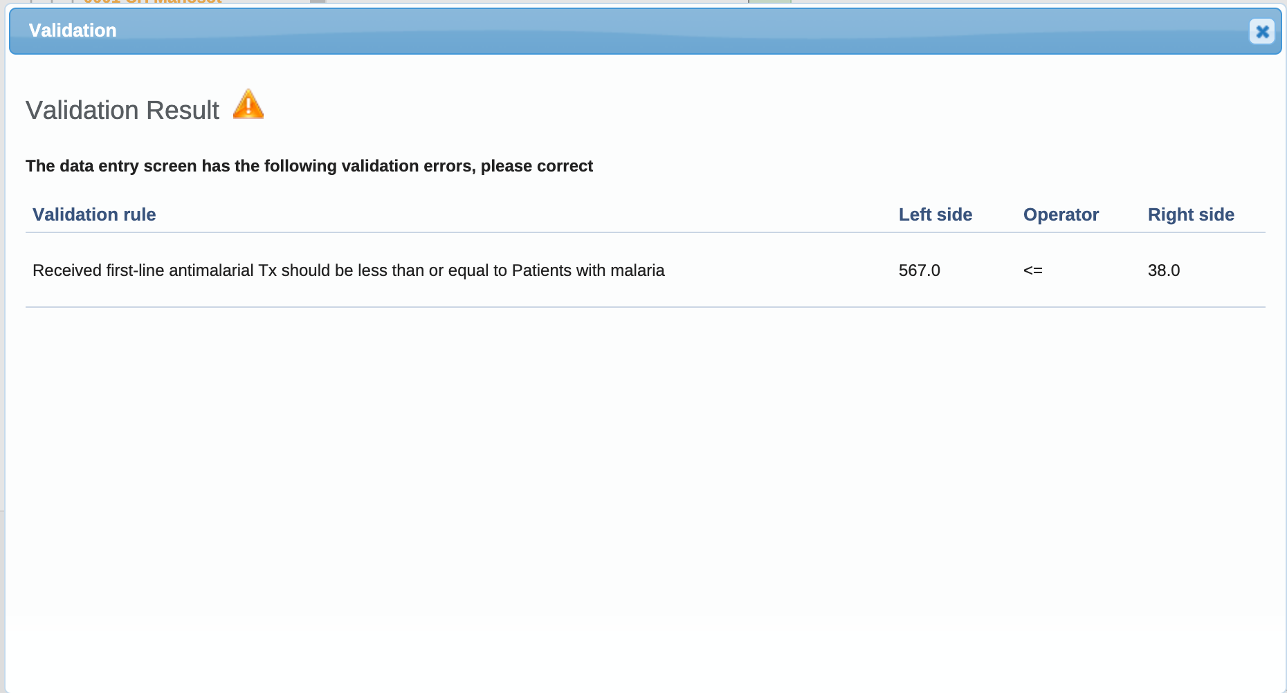
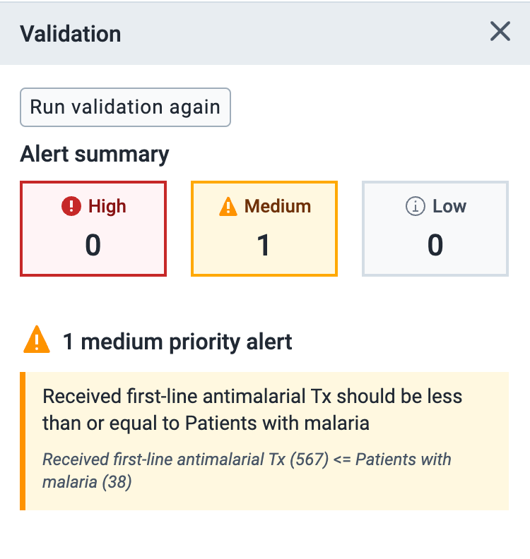
Validation

Slide 9
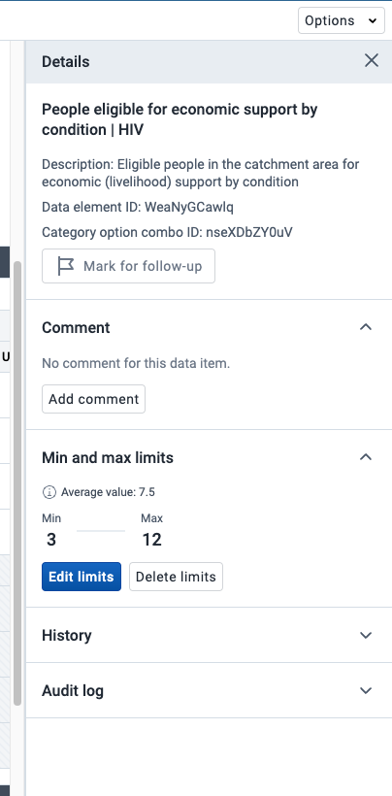
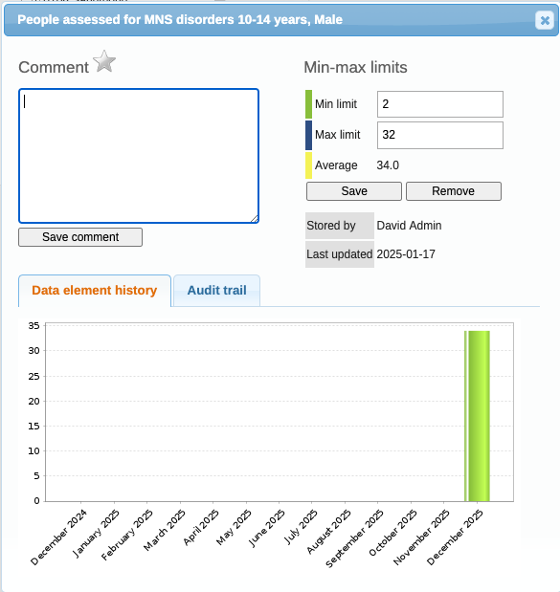
Details including min/max values

Slide 10
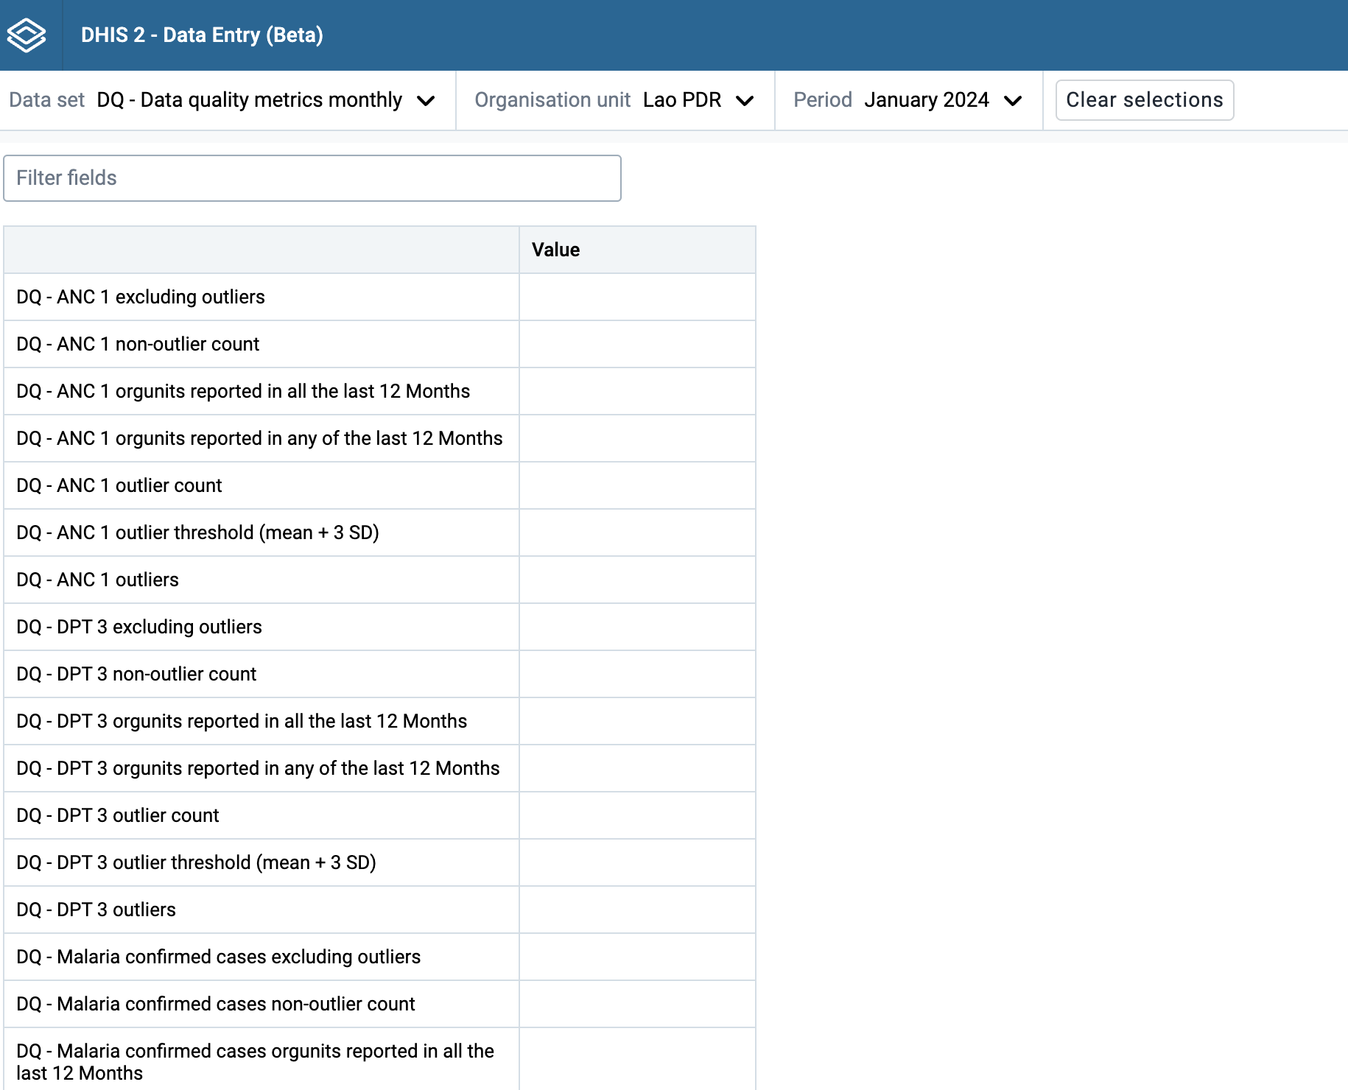
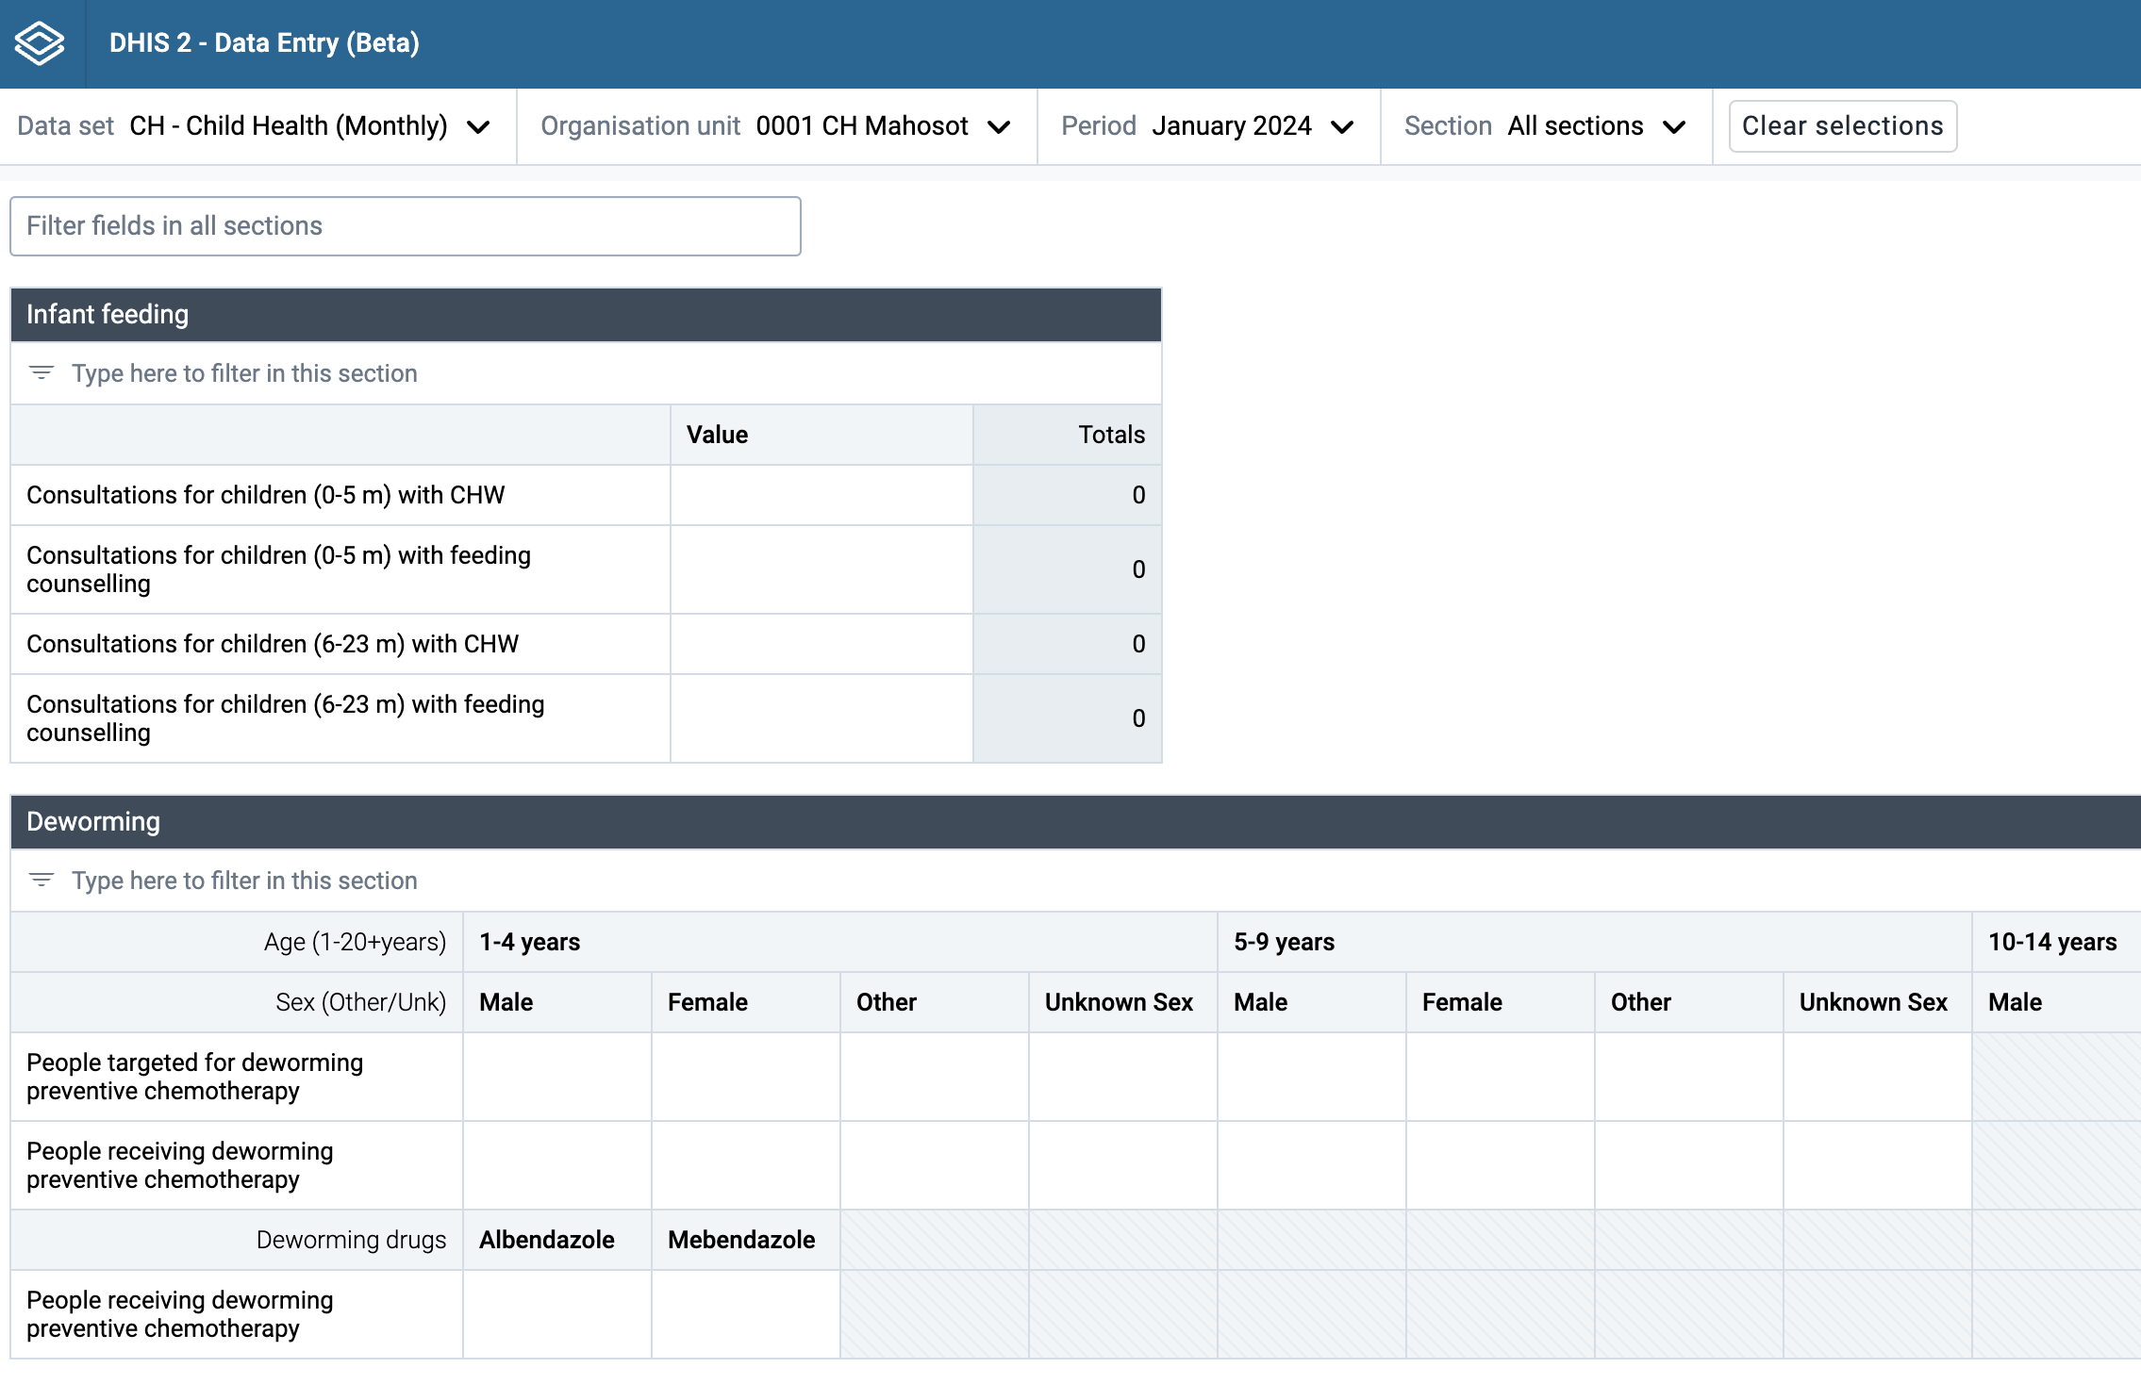
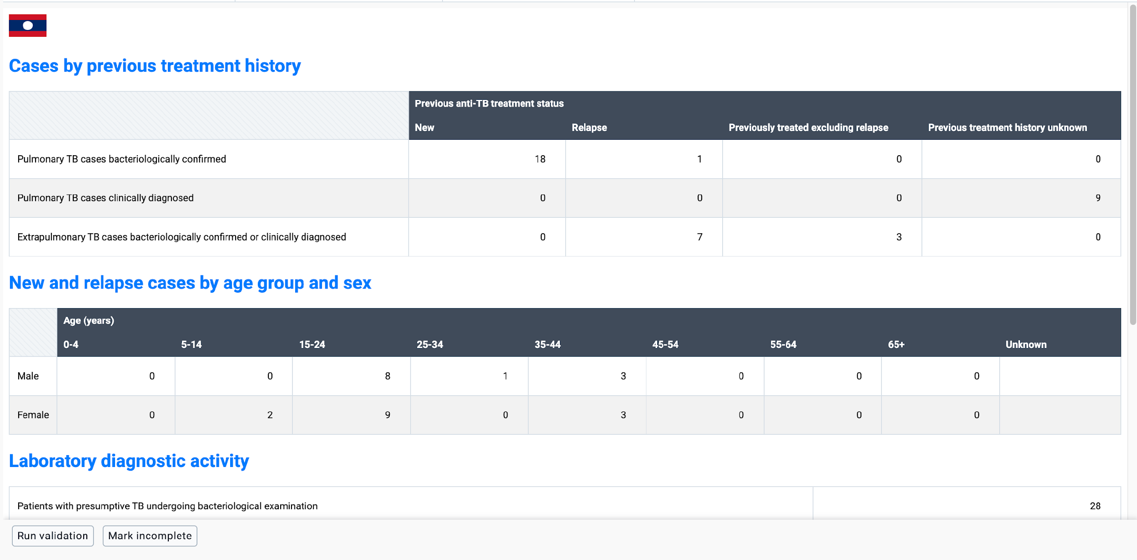
Form types
1. Default
2. Section
3. Custom

Slide 11
Form configuration options
Section Form
Render sections as tabs
Row and Column totals
Disable automatic grouping of data elements
Manage grey fields
Pivot: categories as rows, data elements as columns
Move a category to rows
Add content before and after section
Custom Forms

Slide 12
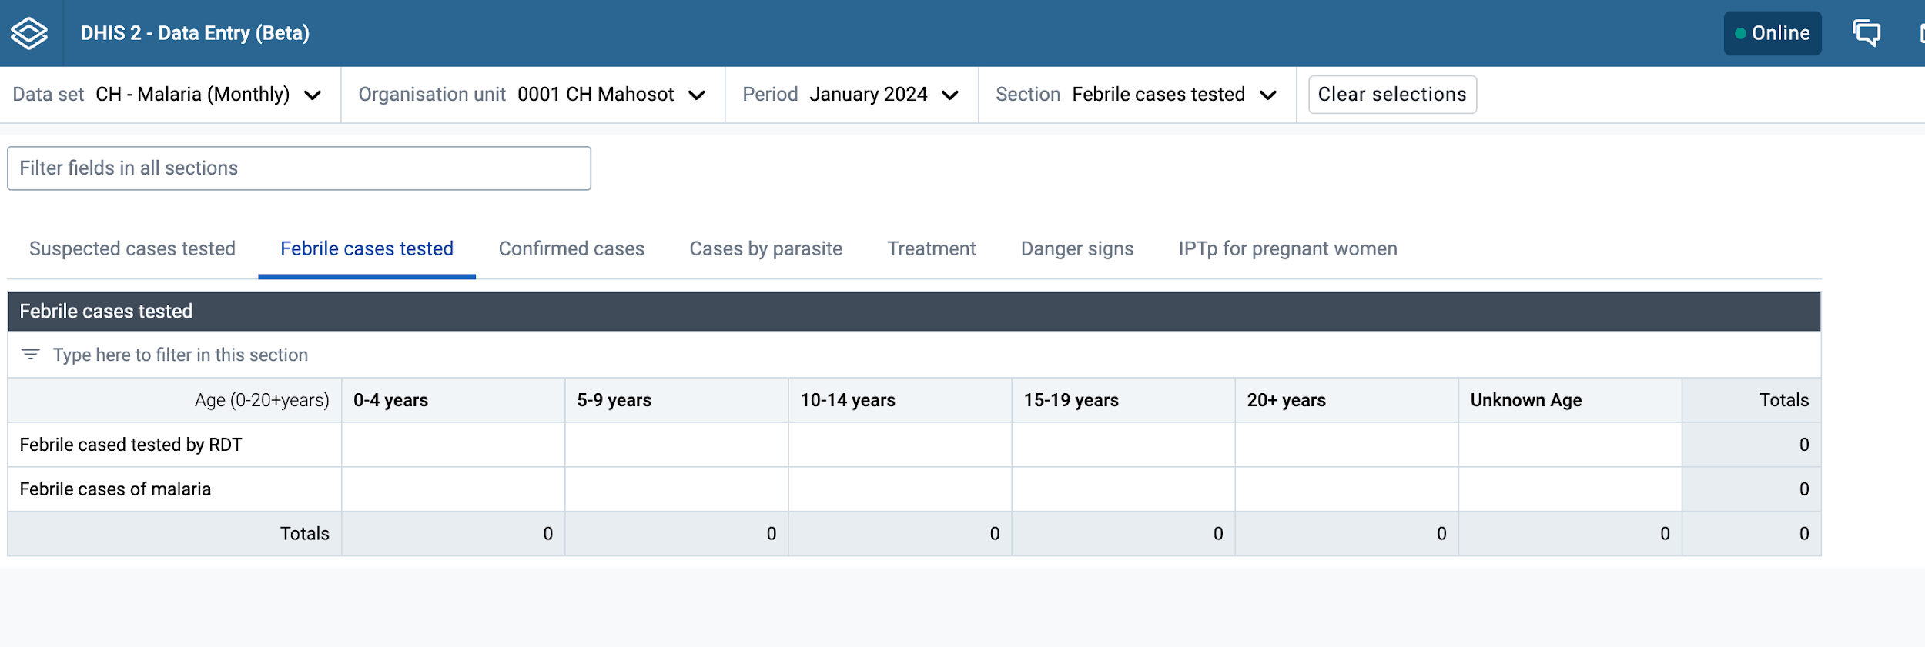
Render sections as tabs

Slide 13
Row and column totals

Slide 14
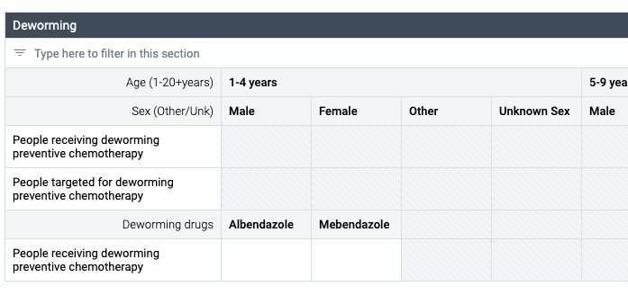
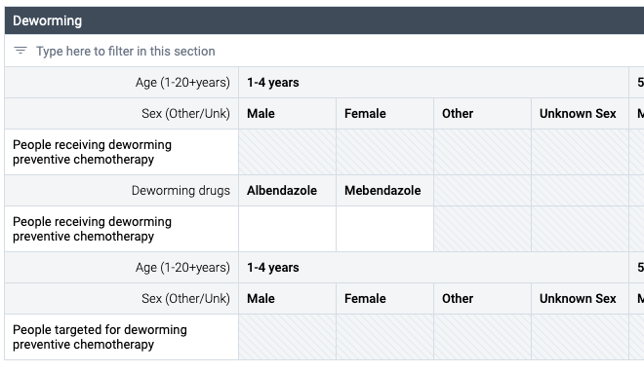
Disable automatic grouping of data elements

Slide 15
Manage grey fields

Slide 16
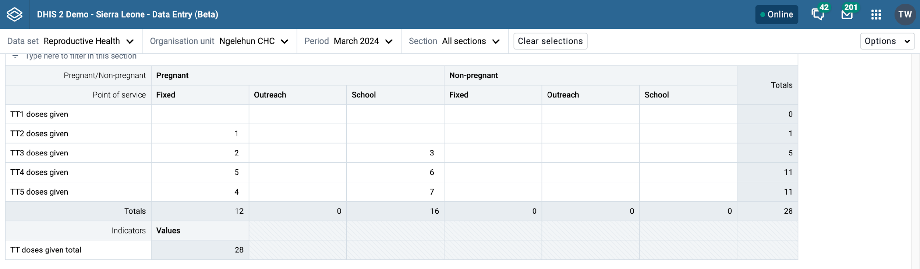
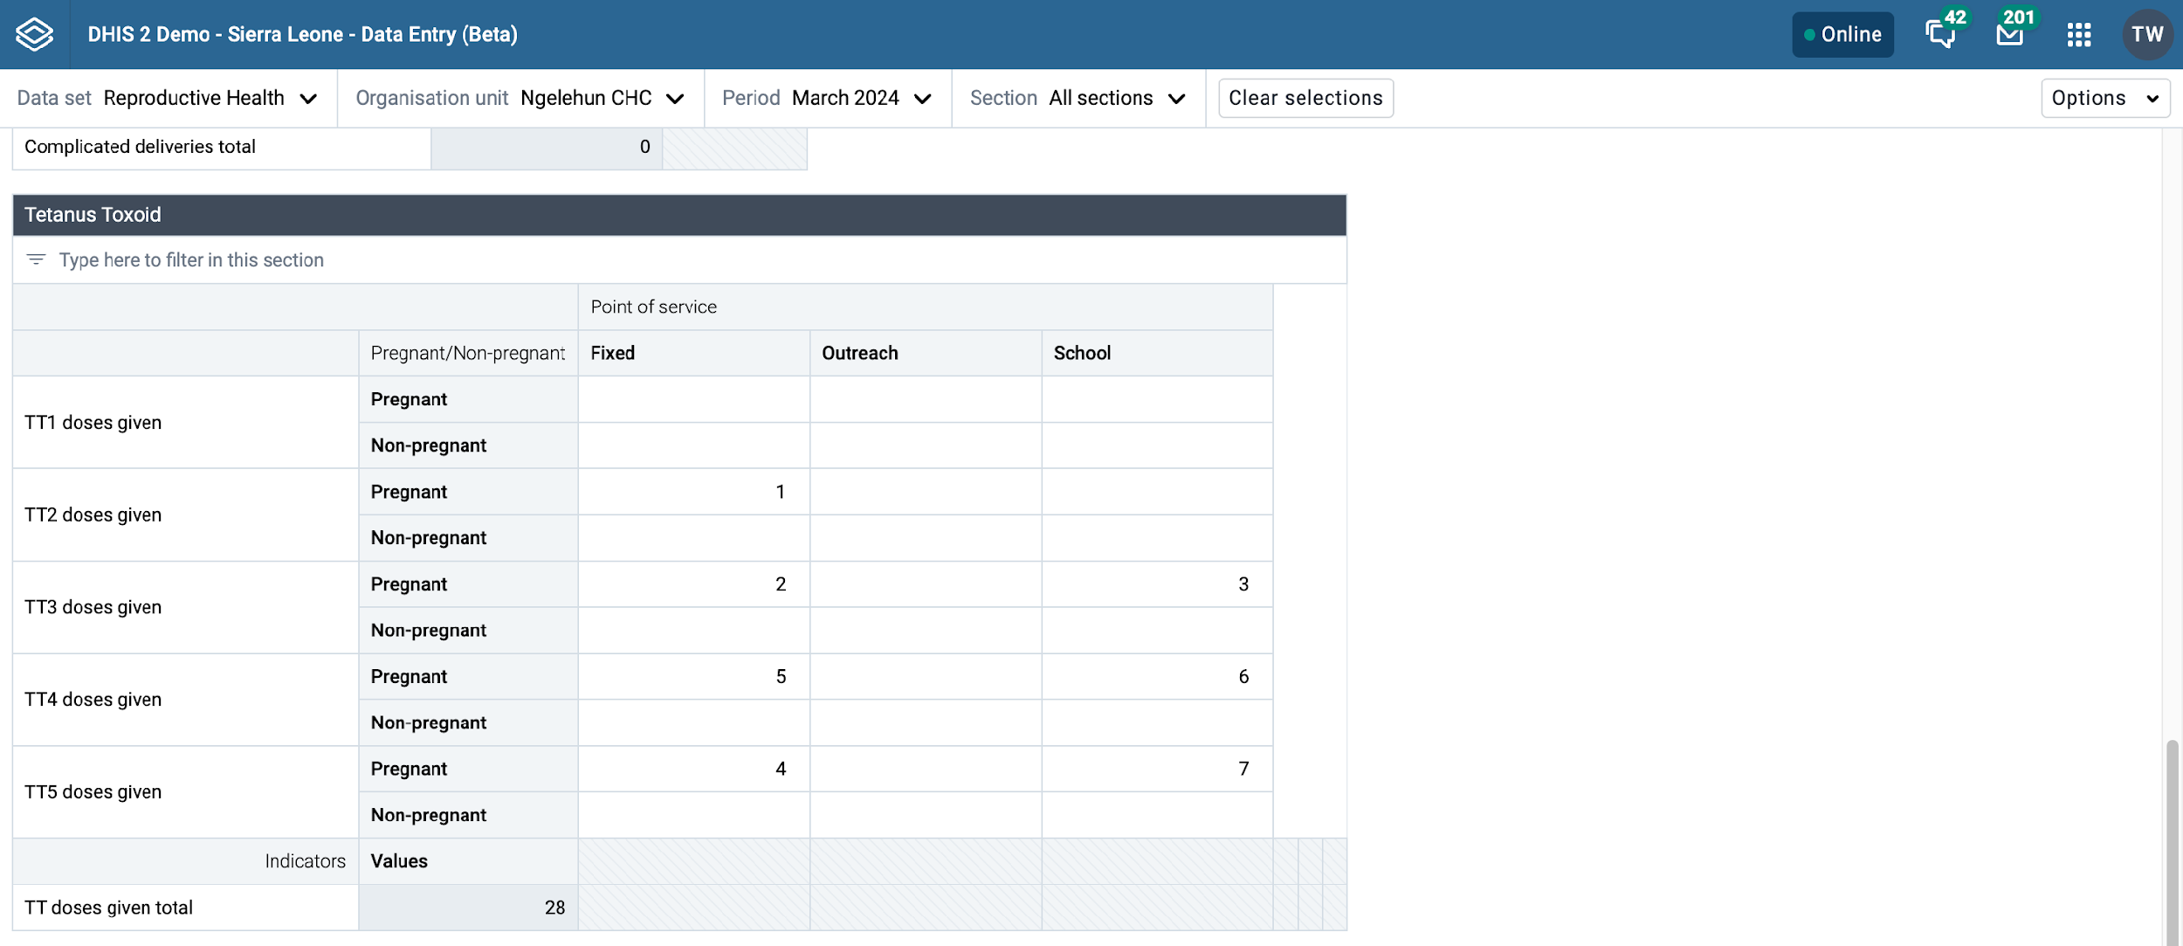
Pivot data elements and categories

Slide 17
Add content before and after section
Allowed HTML tags:
a for adding a link
u for underlining text
b or strong for styling text in bold format
em for styling text in italic format
Notes:
The allowed HTML tags are:
a for adding a link
u for underlining text
b or strong for styling text in bold format
em for styling text in italic format

Slide 18
Custom form

Slide 19
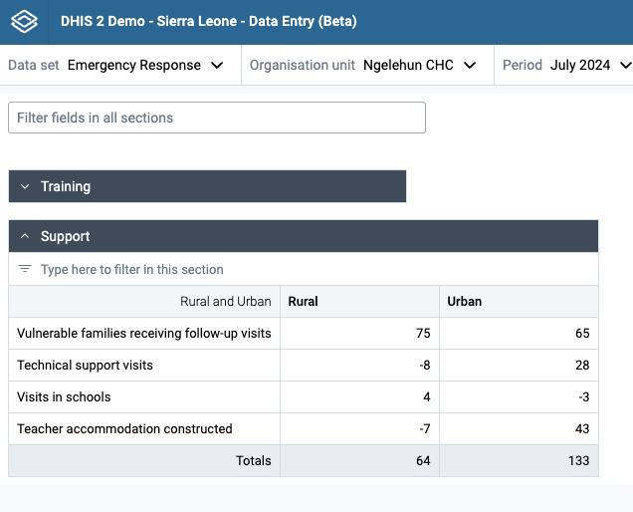
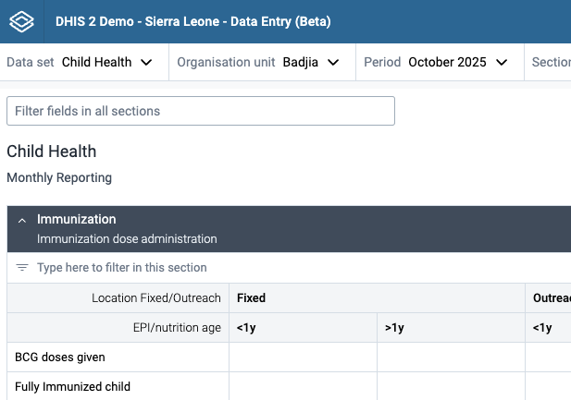
Coming soon in v42
Vertical Tabs
Collapse /expand sections
Form title and subtitle
Notes:
Coming next – program rules, conditional formating, skip logic

